Slide 1

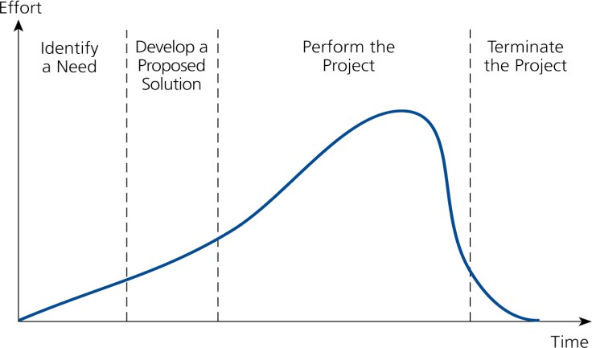
05-04-2025
BITS Pilani, Pilani Campus
Typical Project Life-Cycle
(4 Phases)
Stages (Phases)
I
II
III
IV
BITS Pilani, Pilani Campus

Slide 2
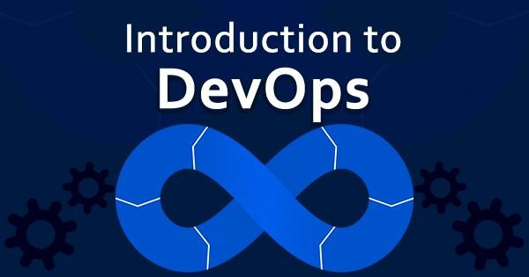
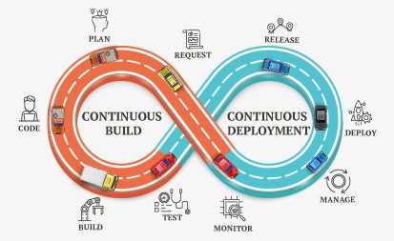


05-04-2025
Dr.S.Udhayakumar
Professor, Department of Computer Science and Engineering mailtoudhay@gmail.com
Course Objectives
No | Objective
CO1 | To learn the key ideas and techniques to bring development and operations together to produce higher-quality software and deliver it more quickly.
CO2 | To learn the core principles, business and technical terms used in DevOps from perspective of business and IT teams
CO3 | To gain knowledge of the Principles and practices of the DevOps Lifecycle including Continuous Integration, Continuous Inspection, Continuous delivery, Continuous deployment and Continuous monitoring.
CO4 | To understand the usage of tools and technologies used for implementing DevOps.

Slide 3
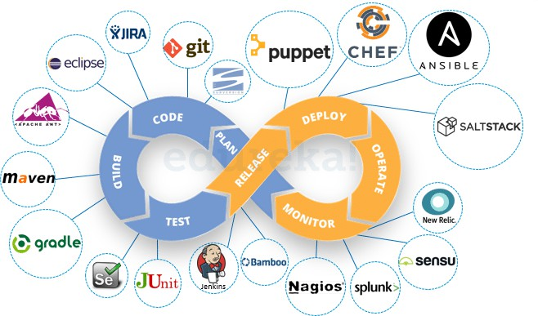
05-04-2025
Text books and References
No | Author(s), Title, Edition, Publishing House
T1 | DevOps: A Software Architect's Perspective (SEI Series in Software Engineering) by Len Bass, Ingo Weber, Liming Zhu , Publisher: Addison Wesley (18 May 2015).
T2 | Continuous Delivery: Reliable Software Releases through Build, Test, and Deployment Automation by Jez Humble, David Farley. Publisher: Addison Wesley, 2011
No | Author(s), Title, Edition, Publishing House
R1 | Effective DevOps: Building A Culture of Collaboration, Affinity, and Tooling at Scale by Jennifer Davis , Ryn Daniels. Publisher: O'Reilly Media, June 2016
R2 | The DevOPS Handbook: How to Create World-Class Agility, Reliability, and Security in Technology Organizations by Gene Kim, Patrick Debois, John Willis, Jez Humble, John Allspaw. Publisher: IT Revolution Press (October 6, 2016)
R3 | Web Resources: https://jenkins.io/ https://xebialabs.com/solutions/devops/ https://www.ibm.com/ibm/devops/us/en/casestudies/#all https://git-scm.com/ https://hub.docker.com/ https://www.atlassian.com/git/tutorials/comparing-workflows https://www.tutorialspoint.com/puppet/ https://www.tutorialspoint.com/chef/
Module 1 Why and What is DevOps?
RL1.1 Foundational
The Waterfall approach advantages and disadvantages
DevOps
Define the stages of a DevOps evolution
DevOps practices in organizations
The Continuous DevOps LifeCycle Process (Continuous Integration, Continuous Inspection, Continuous Deployment, Continuous Delivery, Continuous Monitoring)
Case Study- (IBM/Facebook/NetFlix)
Terminology and Concepts
RL1.1.1 Agile Methodology
RL1.1.2 Operational
Methodologies: ITIL
RL 1.2 Software Delivery
RL2.1.1 Problems of Delivering
Software
RL 2.1.2 Principles of Software
Delivery
RL 1.3 About DevOps
RL2.2.1 Need for DevOps
RL2.2.2 Evolution of DevOps
RL2.2.2 DevOps Practices

Slide 4
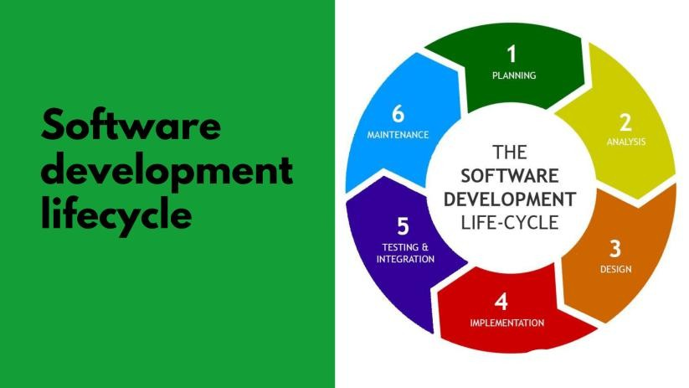
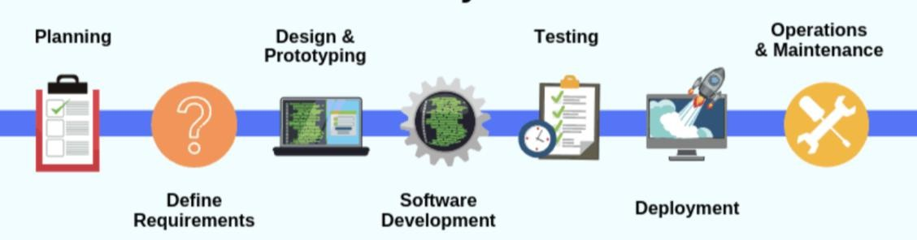
05-04-2025
Software Development Life Cycle (also called SDLC)
Software Development Life Cycle (SDLC) is a process used by the software industry to design, develop and test high-quality software’s.
The SDLC aims to produce high-quality software that meets or exceeds customer expectations, reaches completion within times and cost estimates.
System analysts can use it, designers and developers to plan and implement the applications and deliver the systems or products on time and within budget.

Slide 5
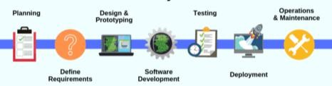
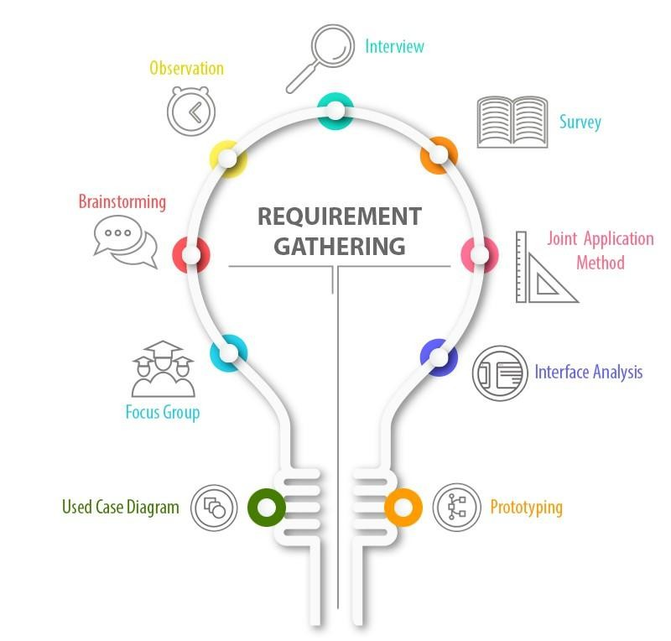
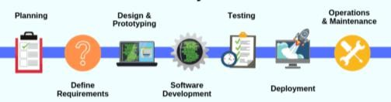
05-04-2025
Project Initiation
The high-level scope, problems and solutions are determined, and
planning is carried out accordingly for other stages.
Business Analyst Training
Other components that are to be considered in this stage are Resources, time/schedules, milestones, cost, business benefits and deadlines.
In the case of enhancements to existing projects, the strengths and weaknesses of the current software are studied, and the improvements are set as a goal, along with the collected requirements.
Business requirements are gathered. Meetings with project managers and stakeholders.
Identify
“Who will use the system”
“How the system should work “
“What should be the input & output of the system”
Analyze requirements for validity & incorporation of requirements Finally, prepare Requirement specification document

Slide 6
05-04-2025
Requirements Gathering
The requirements are of the type:
Functional Requirements
Non-functional Requirements
The end-user requirements from the customer and other stakeholders (salespeople, domain/industry experts, etc.) are collected.
Requirements are gathered using the following techniques:
By conducting Interviews
By conducting Workshops
By conducting Surveys and questionnaires
Focus Groups
Observations / time study
By conducting Brainstorming Sessions
Document Analysis (Ex: Regulatory
requirements)
Mind Mapping
Benchmarks
Analysis
The Analysis Phase is where you break down the deliverables in the high-level Project Charter into the more detailed business requirements.
A Software Requirement Specification (SRS) document is used in the analysis phase, which specifies the software, hardware, functional, and network requirements of the system is prepared at the end of this phase.
•
In this, every achievable requirement is anlyzed and documented as Software Requirements Specifications (SRS) or Functional Requirements Specifications (FRS).

Slide 7
05-04-2025
System Design
• This is the stage which stated, “How to achieve what is needed?”
• Software Requirements Specifications (SRS) are now transformed to the system design plan, which contains a detailed and complete set of specifications, commonly known as “Design Specification”.
• Prepare design of network, databases, application, system interfaces, user interfaces, system and software design from software requirement specification.
• •
All the technical details like technologies to use, project constraints, team’s
capability, etc. goes into the design specification document.
• The technical architects and developers develop the logical plan of the system which is then reviewed by all the stakeholders.
• Design a contingency, training, maintenance, and operation plan.
• At last, prepare a design document which will be used during next phases.
Development
When the design process of the software is over, the next step will be the coding. In this step, developers start constructing the whole framework using the programming language chosen to write code.
Tasks are divided into units or modules in the coding process and allocated to the specific developers. Coding is the enormous step of the SDLC.
Developers will obey specific predefined coding guidelines during this process.
They will also use programming tools such as compilers, interpreters,
debuggers to build and execute the code.

Slide 8
05-04-2025
Testing
When the coding is complete, testing begins, and the modules are released for
evaluation as software testing is necessary to avoid any bugs.
The created software is extensively reviewed during this process, and any issues found are assigned to developers to repair them.
Retesting and regression testing are conducted until the software is as planned by the expectation of consumers.
Testers refer to the SRS document to make sure the software conforms to the
customer’s standard.
Software Deployment
In this phase, the goal is to deploy the software to the manufacturing environment so that consumers can start using the product. Many companies, however, prefer to push the product across different delivery environments such as a testing or staging area.
It enables every stakeholder to play with the product safely before it is introduced into the market. Therefore, this allows us to catch any final mistakes before launching the product.

Slide 9
05-04-2025
Maintenance
When the software passes through all the stages without any complications, a maintenance cycle is to be performed in which it is updated and modified from time to time to adapt to changes.
Here are some benefits of SDLC are given below:
Using the SDLC it is easy to measure the growth and costs of the developed system
SDLC enhances the control and monitoring of the big or complex projects.
SDLC involves well detailed and comprehensive steps.
The design reviews help to ensure the reliability and quality of the developed
solution.
SDLC provides extensive documentation of the system.

Slide 10
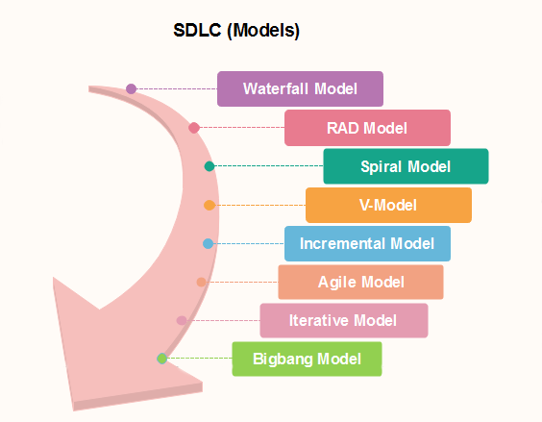
05-04-2025
Software Development Life Cycle
SDLC Phases
Requirement Analysis
Design
Development
Testing
Release
Feedback
Maintenance
SDLC Models

Slide 11
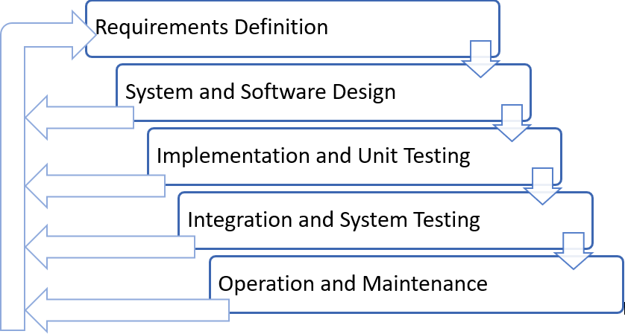
05-04-2025
Waterfall Model
Introduction
It is also called as the classic life cycle
Waterfall Model is considered as Black Box Model
One can not go back to previous phase
Sequential in Nature
This suggests a systematic, sequential approach to software development that begins with customer specification of requirements
And progresses through
Planning
Modeling
Construction
Deployment
and Culminating in ongoing support of the completed software
Waterfall Model Contd..
Feedback Amendment in Waterfall Model

Slide 12
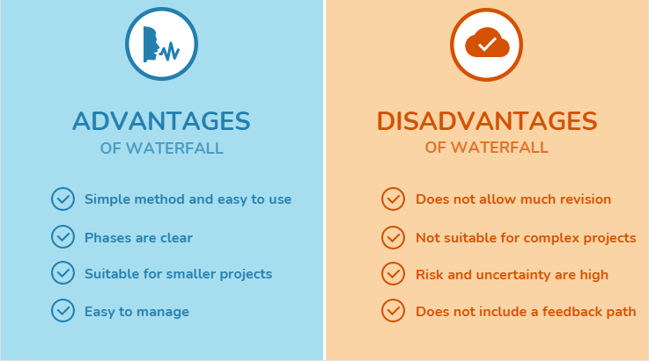
05-04-2025
Waterfall model pros and cons
Waterfall Model Contd..
Waterfall Model Strong Points
Easy to understand, easy to use
Provides structure to inexperienced staff
Milestones are well understood
Sets requirements stability
Good for management control (plan, staff, track)
Works well when quality is more important than cost or schedule
Limitation of the Waterfall Model
Not suitable for the project where requirements are
changing.
The high amount of risk and uncertainty
Not good for the object-oriented project
Poor model for long and ongoing project
Can give a false impression of progress
Integration is one big bang at the end
Little opportunity for the customer to preview the system

Slide 13
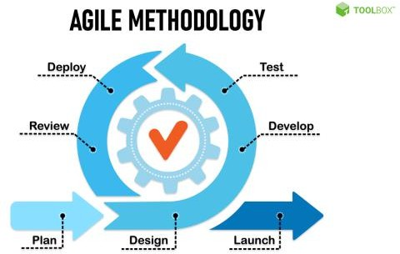
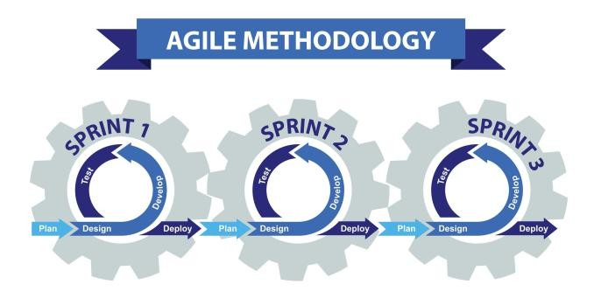
05-04-2025
Suitable Situation to use Waterfall Model
Work well for a small project
When Requirements are very well known
When Product definition is stable
When Technology is understood
When New version of an existing product
When Porting a current product to a new platform.
Agile Methodology

Slide 14
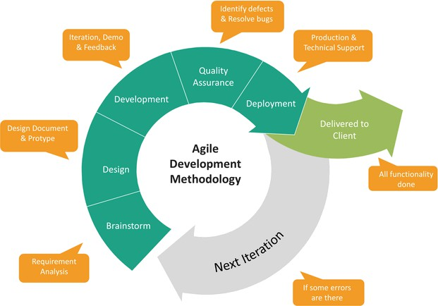
05-04-2025
Need of Agile
Why Agile?
The biggest problem with software development is changing requirements
Agile processes accept the reality of change versus the hunt for complete, rigid specifications
Speed up or bypass one or more life cycle phases
Usually less formal and reduced scope
Used for time-critical applications
Used in organizations that employ disciplined methods
Storm called Agile
According to VersionOne's State of Agile Report in 2017 says 94% of organizations practice Agile, and in 2018 it reported 97% organizations practice agile development methods

Slide 15




05-04-2025
Agile Methodology Contd..
Agile – Background
Agile was formally launched in 2001
17 technologists drafted the Agile Manifesto
Kent Beck | Mike Beedle |  | Arie van Bennekum |  | Alistair Cockburn |  | Ward Cunningham |  | Martin Fowler
James Grenning | Jim Highsmith |  | Andrew Hunt |  | Ron Jeffries |  | Jon Kern |  | Brian Marick
Robert C. Martin |  | Steve Mellor |  | Ken Schwaber |  | Jeff Sutherland |  | Dave Thomas
Agile Model Strong Points
It can adapt well with changing requirement
Deliver a working product faster than a conventional linear development model
Customer feedback at every stage ensures that the end deliverable satisfies their expectations
No guesswork between the development team and the customer, as there is face to face communication and continuous inputs from the client
Decrease the time required to avail some system features.
A test can be conducted during the design cycle
Fewer risks and has more flexibilities
Modification in the system needs less time
The result is high-quality software in the least possible time duration and satisfied customer.

Slide 16
05-04-2025
Agile Model Limitations
More Programmer centric than user-centric
For larger projects, it is difficult to judge the efforts and the time required for the project in the SDLC.
Since the requirements are ever-changing, there is hardly any emphasis, which is laid on designing and documentation. Therefore, chances of the project going off the track easily are much more
Scalability
The ability and collaboration of the customer to express user needs.
Documentation is done at later stages.
Reduce the usability of components.
Needs special skills for the team.
Principles of Agile Methodology
Twelve Principles
Our highest priority is to satisfy the customer through early and continuous delivery of valuable
software
Welcome changing requirements, even late in development. Agile processes harness change for the customer's competitive advantage
Deliver working software frequently, from a couple of weeks to a couple of months, with a preference to the shorter timescale
Business people and developers must work together daily throughout the project
Build projects around motivated individuals. Give them the environment and support they need, and trust them to get the job done
The most efficient and effective method of conveying information to and within a development team is face-to-face conversation
Working software is the primary measure of progress
Agile processes promote sustainable development. The sponsors, developers, and users should be
able to maintain a constant pace indefinitely
Continuous attention to technical excellence and good design enhances agility
Simplicity--the art of maximizing the amount of work not done--is essential
The best architectures, requirements, and designs emerge from self-organizing teams
At regular intervals, the team reflects on how to become more effective, then tunes and adjusts its behavior accordingly

Slide 17
05-04-2025
Pillars of Agile Methodology
Agile focuses on
Individuals and interactions
Processes and tools
Working software
Comprehensive
documentation
Customer Collaboration
Contract negotiation
Responding to change
Following a plan
Agile Methodologies
Few of Agile Methodologies
Scrum
Extreme Programming [XP]
Test driven Development [TDD]
Feature Driven Development [FDD]
Behavior-driven development [BDD]

Slide 18
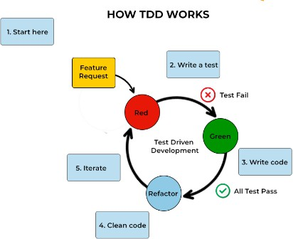
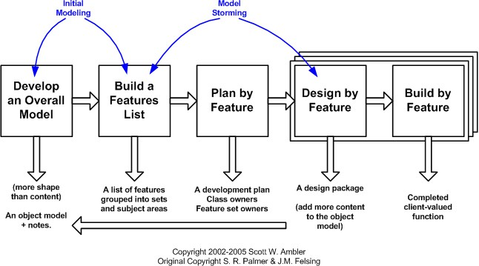
05-04-2025
Test Driven Development,
Feature Driven Development

Slide 19
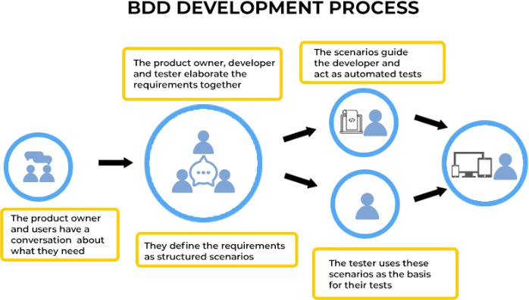
05-04-2025
Behavior-driven
development
Agenda
Operational Methodologies: ITIL
Introduction to Information Technology Infrastructure Library (ITIL)
IT Service Management (ITSM) Lifecycle
ITIL Framework

Slide 20
05-04-2025
Operational Methodology
ITIL
ITIL is a framework of best practices for delivering IT services
The ITIL processes within IT Service Management (ITSM) ensure that IT Services are provided in a focused, client-friendly and cost-optimized manner
ITIL’s systematic approach to IT service management can help businesses
Manage risk
Strengthen customer relations
Establish cost-effective practices
And build a stable IT environment
that allows for
Growth
Scale and
Change
ITIL
ITIL : Origin
Developed by the British government's Central Computer and Telecommunications Agency
(CCTA) during the 1980s
The ITIL first consisted of more than 30 books, developed and released over time, that codified best practices in information technology accumulated from many sources (including vendors' best practices) around the world
ITIL’s contribution aligned with the ISO/IEC 20000 Service Management standard in 2005
Since 2013, ITIL is owned by Axelos — a joint venture between the Cabinet Office and Capita

Slide 21
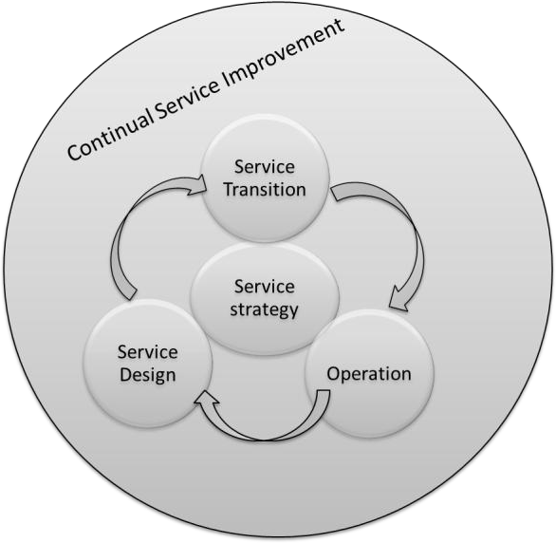
05-04-2025
ITIL
IT Service Management (ITSM) Lifecycle
ITIL views ITSM as a lifecycle
Five Phases:
Service Strategy [design, development, and implementation]
Service Design [design and
development]
Service Transition [development and design]
Service Operation [delivery and support]
Service Improvement [create and maintain value]
ITIL Framework
Service
Strategy
Service
Design
Service Transition
Service Operation
CSI
Demand
Management
Service level
Management
Transition Planning and support
Event Management
Service portfolio Management
Supplier Management
Change Management
Incident Management
Financial Management
Capacity Management
Asset and Configuration management
Problem Management
Business Relationship management
Availability management
Service validation and testing
Request Fulfilment
Release and Deployment Management
Access Management
Continuity
Management
Evaluation
Service Desk
Information Security Management
Knowledge Management
Technical Management
Service catalogue Management
Application Management
Design Coordination
IT Operations

Slide 22
05-04-2025
ITIL
ITIL: Is a Project?
ITIL is not a “Project”
ITIL is ongoing journey
Benefits of ITIL:
Organizations to reduce the operations cost by optimizing the available resource utilizations
Reduce system outages and minimize the impacts of service unavailability
Even most organizations testified with reduction in business critical incidents by 80 to 90% in few years
Agenda
Problems of Delivering Software
Problems of Delivering Software
Release Antipatterns
Principles of Software Delivery

Slide 23
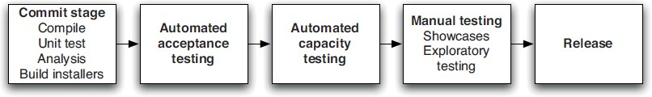
05-04-2025
Problems of Delivering Software
Converting Idea to Product / Service?
Reliable, rapid, low-risk software releases
Ideal Environment
Generic Methodologies for Software Methodologies
More focus on Requirement Gathering
Problems of Delivering Software
Release Antipatterns
Common Quote “The day of a software release tends to be a tense one”
Antipattern: Deploying Software Manually
The production of extensive and detailed documentation for steps to be performed
Reliance on manual testing
Frequent calls to the development team to explain
Frequent corrections to the release process
Sitting bleary-eyed in front of a monitor at 2 A.M

Slide 24
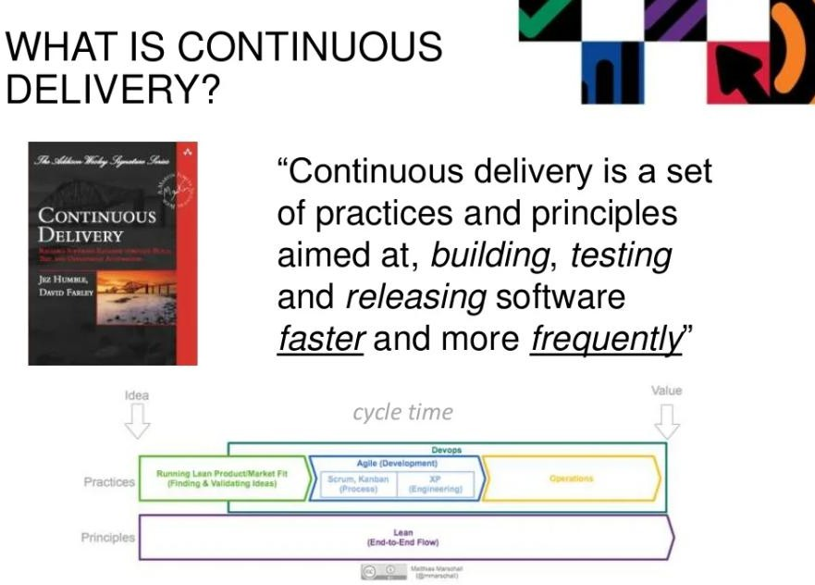
05-04-2025
Problems of Delivering Software
Release Antipatterns Cond..
Antipattern: Deploying to a Production-like Environment Only after Development Is Complete
Tester tested the system on development machines
Releasing into staging is the first time that operations people interact with the new release
Who Assembles? The Development Team
Collaboration between development and Operations?
Antipattern: Manual Configuration Management of Production Environments
Difference in Deployment to Stage and Production
Different host behave differently
Long time to prepare an environment
Cannot step back to an earlier configuration of a system
Modification to Configuration Directly

Slide 25
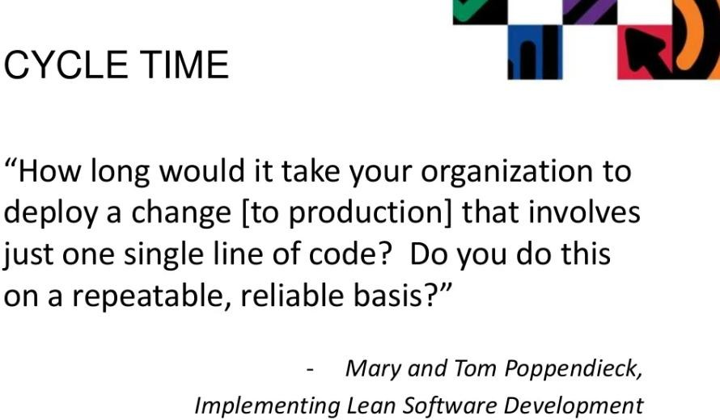
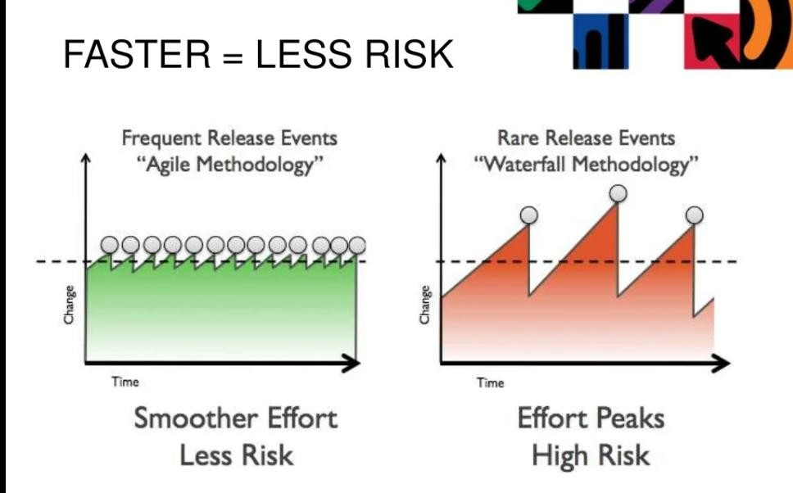
05-04-2025

Slide 26
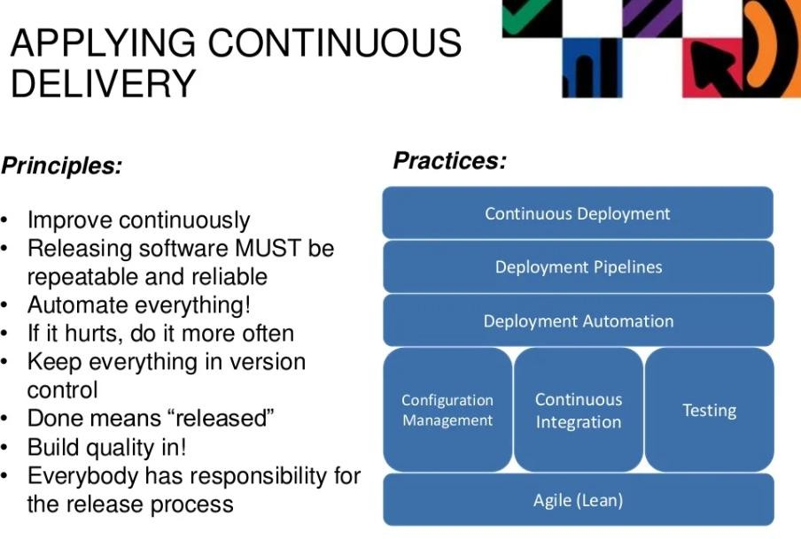
05-04-2025
Continuous Delivery
Introduction to Continuous Delivery
Promotes the adoption of an automated deployment pipeline to release software into production
reliably and quickly
Its goal is to establish an optimized end-to-end process, enhance the development to production cycles, lower the risk of release problems and provide a quicker time to market
To that point, Jez Humble and Dave Farley define the 8 principles of continuous delivery in their Book “Continuous Delivery” as:

Slide 27
05-04-2025
Principle of Continuous Delivery
Build Repeatable and Reliable Process
Use the same release process in all environments
If a feature or enhancement has to work through one process on its way into the integration environment, and another process into QA, issues find a way of popping up
Principle of Continuous Delivery
Try to Automate Everything
Automate builds, testing, releases, configuration changes and everything else
Manual processes are inherently less repeatable, more prone to error and less efficient
Once we automate a process, less effort is needed to run it and monitor its progress – and it will ensure to have consistent results

Slide 28
05-04-2025
Principle of Continuous Delivery
Keep everything in Version Control
Have one source of truth
Keep Code, configuration, scripts, databases, documentation and everything versioned
Principle of Continuous Delivery
Bring the Pain Forward
Deal with the hard stuff first
Time-consuming or error prone tasks should be dealt with as soon as you can
Once you get the painful issues out of the way, the rest will most likely be easier to perfect

Slide 29
05-04-2025
Principle of Continuous Delivery
Ensure Quality – in Build
Create short feedback loops to deal with bugs as soon as they are created
By having issues looped back to developers as soon as they fail post-build test, it will enable them to produce higher quality code quicker
In addition, fewer issues will be found later on in the process, when it will be more expensive to
fix
Principle of Continuous Delivery
Set expectation as "Done" means Released
A feature is done only when it is in production
Having a clear definition of “done” right from the start will help everyone communicate better, and realize the value in each feature

Slide 30
05-04-2025
Principle of Continuous Delivery
Everyone is Responsible
"It works on my workstation" is never a valid excuse
Responsibility should extend all the way to production
Cultural change can be the hardest to implement
However, having management support and an enthusiastic champion will certainly help
Principle of Continuous Delivery
Continuous Improvement
This principle is the most important for effective automation
If "practice makes perfect" then automation represents the ultimate expression of a practice- making-perfect iterative process.

Slide 31
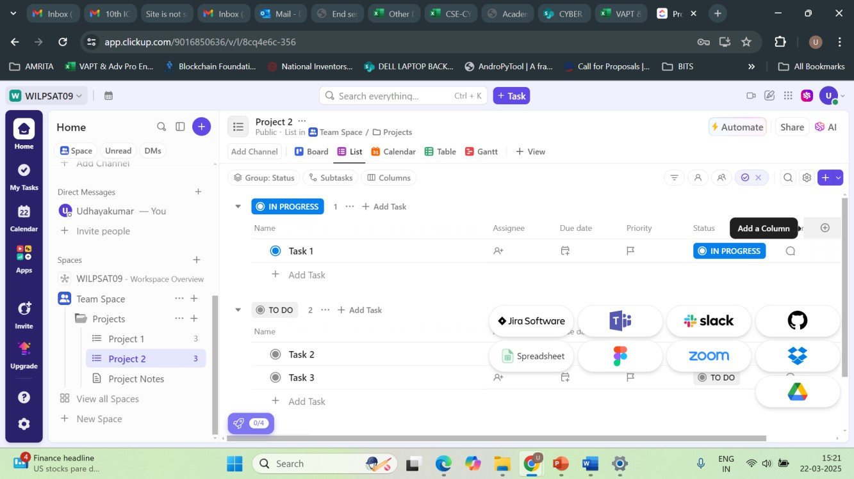
05-04-2025
Principle of Continuous Delivery
Summary
Create a Repeatable, Reliable Process for Releasing Software
Automate Almost Everything
Keep Everything in Version Control
If It Hurts, Do It More Frequently, and Bring the Pain Forward
Build Quality In
“The Earlier you catch the defects, the cheaper they are to fix”
Done, Means Released
Everybody Is Responsible for the Delivery Process
Continuous Improvement

Slide 32
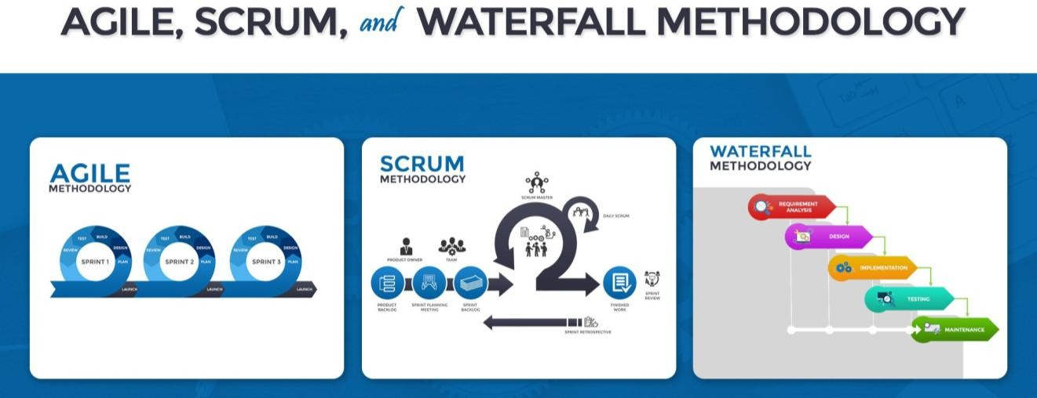
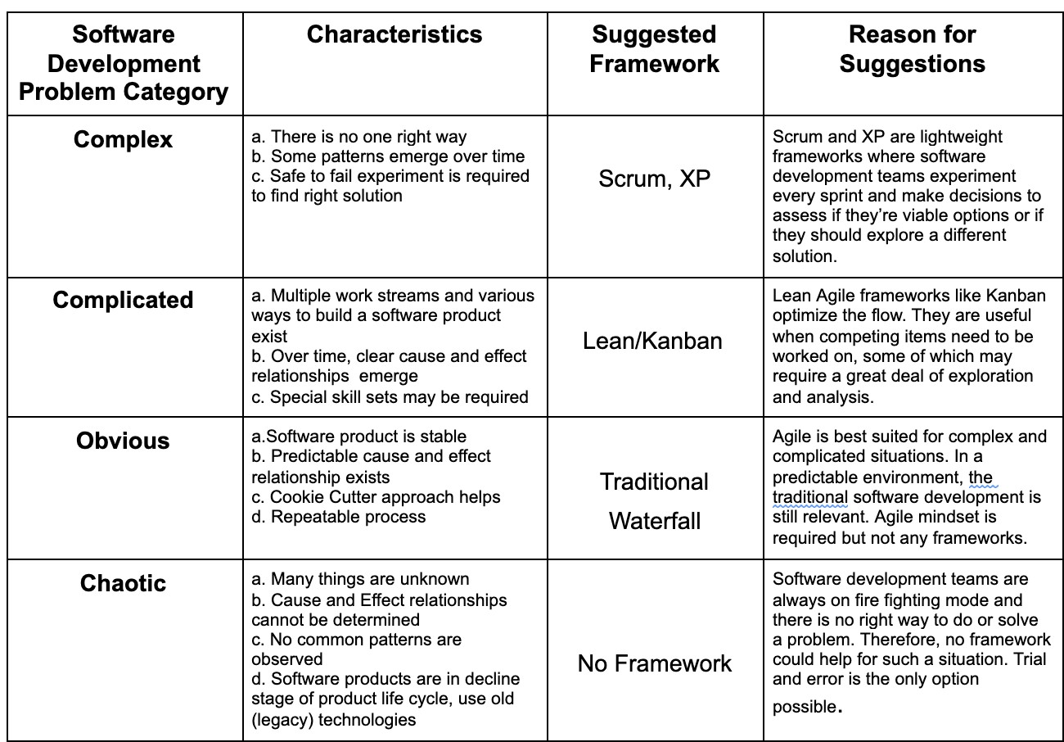
05-04-2025

Slide 33
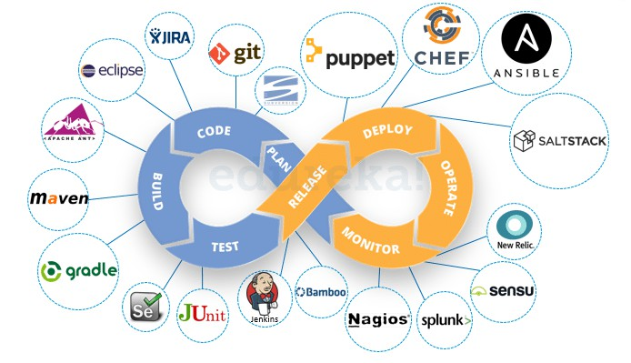
05-04-2025
Dr.S.Udhayakumar Associate Professor, Department of Computer Science and Engineering(Cyber Security)
Module 2 Why and What is DevOps?
About DevOps
RL2.2.1 Need for DevOps
RL2.2.2 Evolution of DevOps RL2.2.2 DevOps Practices
DevOps
Define the stages of a DevOps evolution
DevOps practices in organizations
The Continuous DevOps LifeCycle Process (Continuous Integration, Continuous Inspection,
Continuous Delivery, Continuous
Deployment, Continuous Monitoring)
Case Study- (IBM/Facebook/NetFlix)

Slide 34

05-04-2025
DevOps (Development and Operations)
DevOps (development and operations) is a collection of tools and technologies combined to carry out various business processes.
It aims to bridge the gap between two of the most significant departments
in any IT organization, the
development department,
and the
operations department.

Slide 35
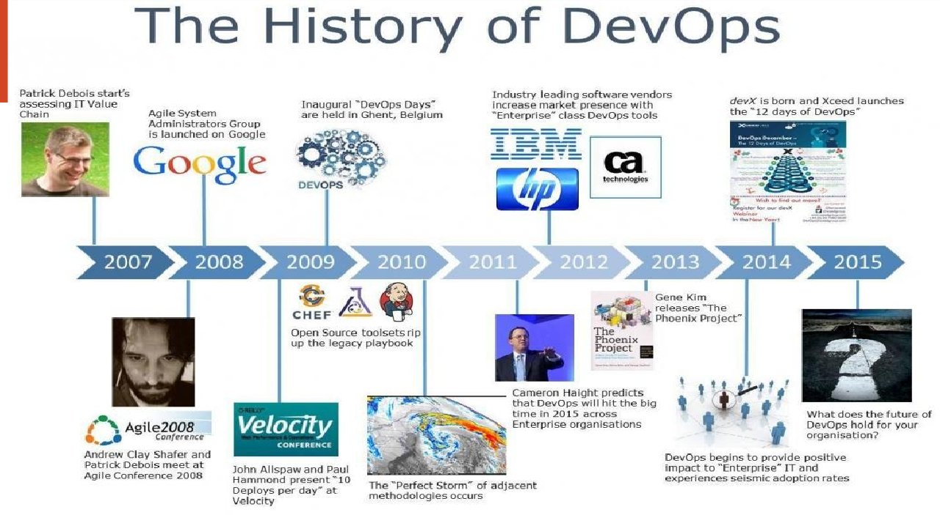
05-04-2025
History of DevOps
Before DevOps came into the limelight, IT had two separate teams in an organization – the Development team and the Operations team.
The development team worked on the software, developing it and making sure that the code worked perfectly.
After hours of hard work and a lot of trial and error, the team releases a code that has to be executed by the Operations team which is responsible for the release and operation of the code.
The operations team will be checking the application and its performance and reporting back any bugs, if present.

Slide 36
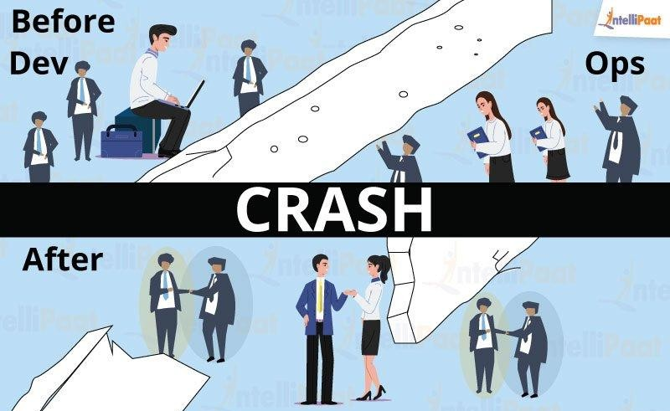
05-04-2025
Before DevOps – a scenario
As simple and planned out as it may sound, the two major teams always had a conflict when it came
to execution.
For instance, let us say, the development team developed a code using an i7 processor, 8GB RAM, OS as Ubuntu, and PHP 5.6 scripting language, whereas the Operations team ran the same code using i5 processor, 16GB RAM, OS as Centos and PHP 7.0 programming language.
When the operations team ran the same code, it wouldn’t work.
The reason for this could be the difference in the system environment or any missing software library.
The operations team flagged this code as faulty, even though the problem could exist in their own system. This resulted in a lot of back and forth between the Developers and the Operations team.

Slide 37


05-04-2025
After DevOps
To bridge this gap, Development(‘Dev’) team and Operations (‘Ops’) team collaborated giving rise
to DevOps.
For example, to solve the above problem, the Development team encapsulated their code in a
container which is a lightweight software environment.
This software environment had all the required software encapsulated in it, which the code or the application will require to run as expected.
When the developers were done with their work, they would simply pass on this container along with the code to the operations team.
The Ops will run this container, along with the code, and it worked as expected!
What is DevOps?
DevOps is not a tool or a team, it is the process or a methodology of using various tools to solve the problems between Developers and Operations team, hence the term “Dev-Ops”
The development team always had the pressure of completing the old, pending work that was considered faulty by the operations team. With DevOps, there is no wait time to deploy the code and get it tested.
Hence, the developer gets instantaneous feedback on the code, and therefore can close the bugs, and can make the code production ready faster!

Slide 38
05-04-2025
DevOps
It is a philosophy that encourages adopting iterative software development, automation, and programmable infrastructure deployment and maintenance.
DevOps emphasizes building trust and better liasioning between developers and system administrators.
This helps the organization in aligning technological projects to business requirements.
Changes rolled out are usually small and reversible, which the entire team begins to comprehend.
The infinite Loop
DevOps is visualized as an infinite loop comprising the steps: plan, code, build, test, release,
deploy, operate, monitor, then back to plan, and so on.

Slide 39
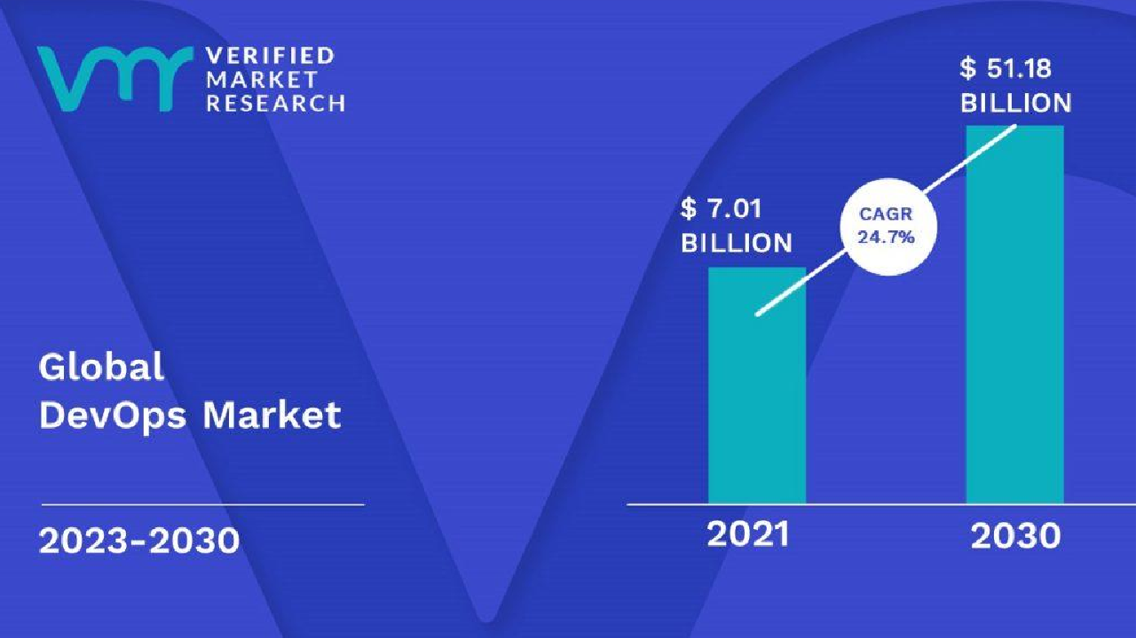
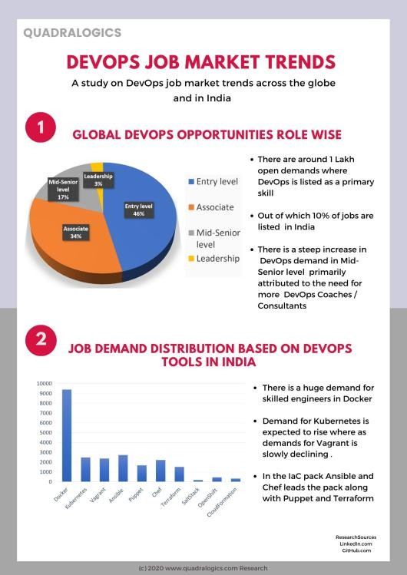
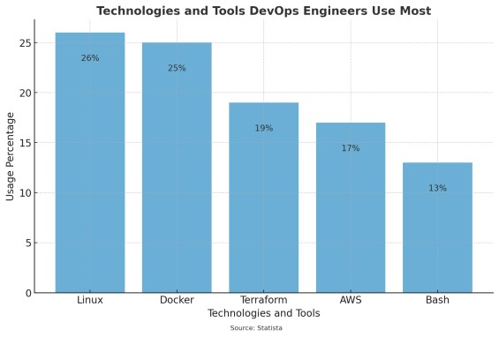
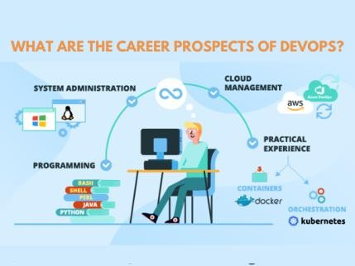
05-04-2025

Slide 40
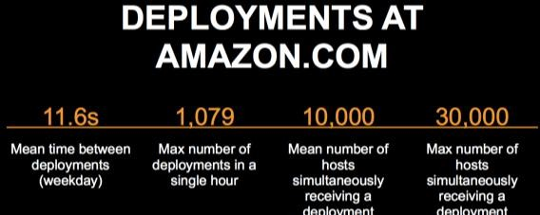
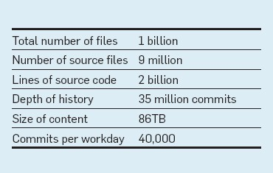

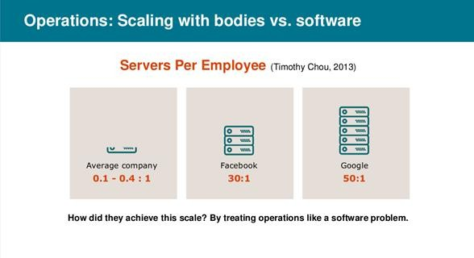


05-04-2025
Evolution of DevOps- Define the stages
of a DevOps evolution
BITS Pilani, Pilani Campus
Evolution of DevOps- Define the stages of a DevOps evolution
BITS Pilani, Pilani Campus

Slide 41
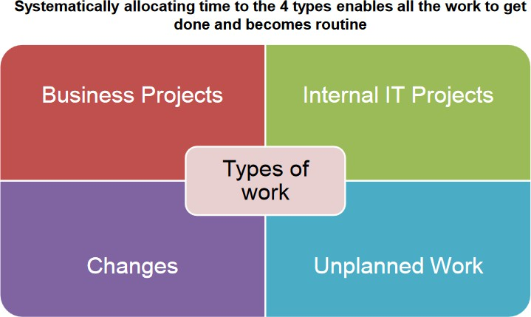
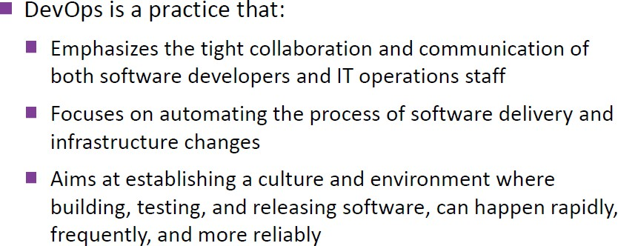
05-04-2025
DevOps practices in organizations
BITS Pilani, Pilani Campus
The Practice
BITS Pilani, Pilani Campus

Slide 42
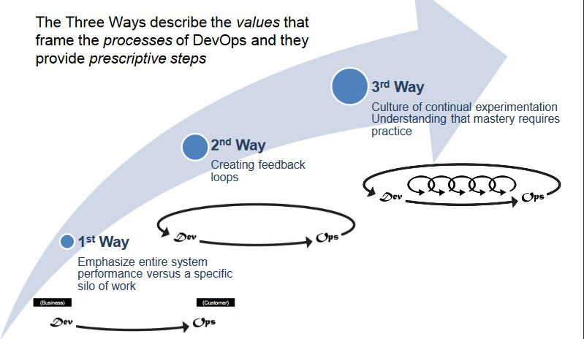
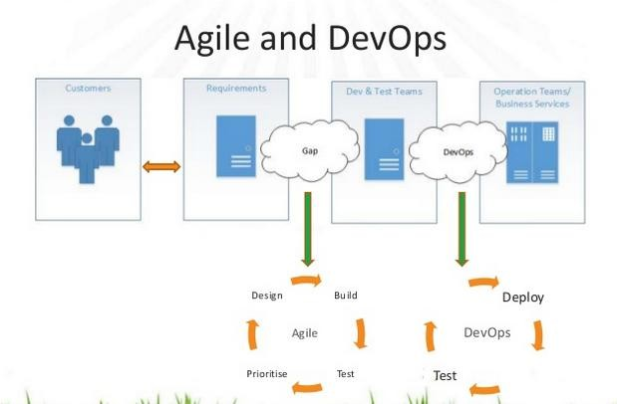
05-04-2025
How it works
BITS Pilani, Pilani Campus
Agile and DevOps
BITS Pilani, Pilani Campus

Slide 43
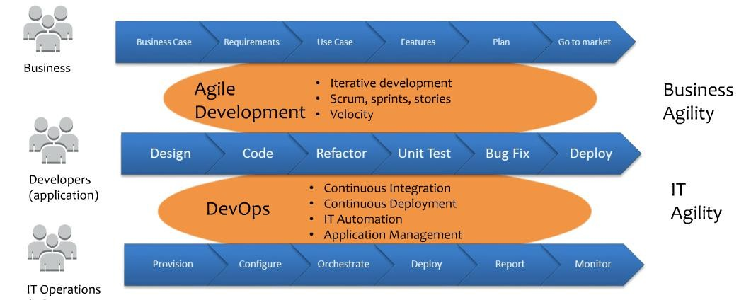
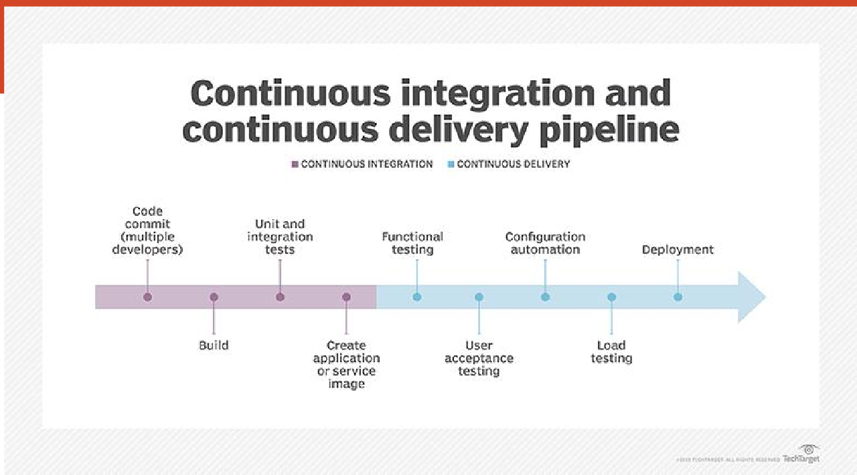
05-04-2025
Agile and DevOps
BITS Pilani, Pilani Campus

Slide 44
05-04-2025
1.BUILD AUTOMATION
An automated code is prepared to be deployed in a live environment where the tool used is tied to the programming language chosen.
This makes the whole process faster, consistent and more repeatable.
Further, it also ensures that your process is more reliable than any manual build.
2. CI/ CD – Continuous Integration and Continuous Deployment
CI/ CD – Continuous Integration and Continuous Deployment deals with frequent merging of codes and unit testing.
Further, the deployment of small code changes in a routine and frequent process is also a part of this method.
CI/CD helps massively as it helps you detect bugs early and maintains the use of modular code with minimal effort. It also reduces the time to market and introduces reliable rollbacks.

Slide 45
05-04-2025
3. INFRASTRUCTURE AS CODE
INFRASTRUCTURE AS CODE – This is usually to manage and provision IT infrastructure through code and automation.
This is reusable, and helps in consistent resource creation and management.
Furthermore, the infrastructure is self-documenting and simplifies complex material like authentication and application servers.
4. CONFIGURATION MANAGEMENT
CONFIGURATION MANAGEMENT – This is the process where you can manage and change the state of infrastructure in constant and maintainable ways.
This way, you end up saving a lot of time while also minimizing configuration drift, especially in large server environments.
Configuration Management also helps provide insight documentation on infrastructure.

Slide 46
05-04-2025
5. ORCHESTRATION
ORCHESTRATION – Orchestration is nothing but an automation that supports processes and workflows, like Resource Planning.
It not only helps you save time, but you also achieve stability, especially with an automatic response to detection of various problems.
6. MONITORING
MONITORING – By this method, you collect and present data about the performance and stability of services and infrastructure, while also detecting problems.
This enables faster recovery, helps with cross-team visibility, provides more data to analyze for better root-cause analysis and also generates an automated response.

Slide 47
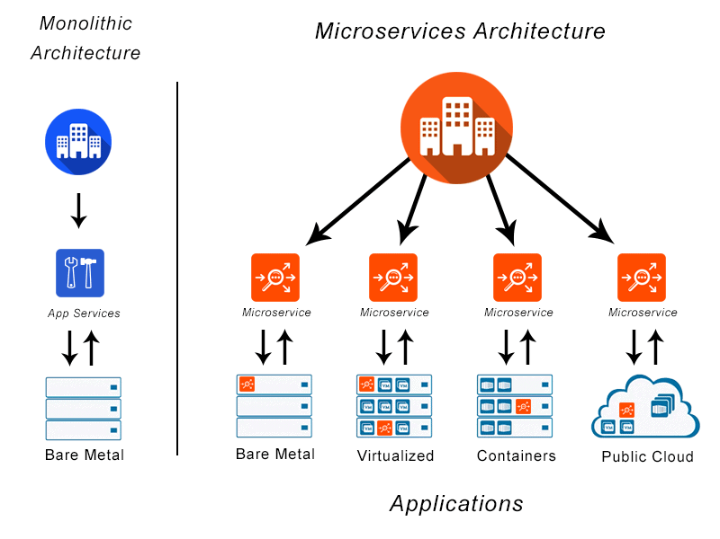
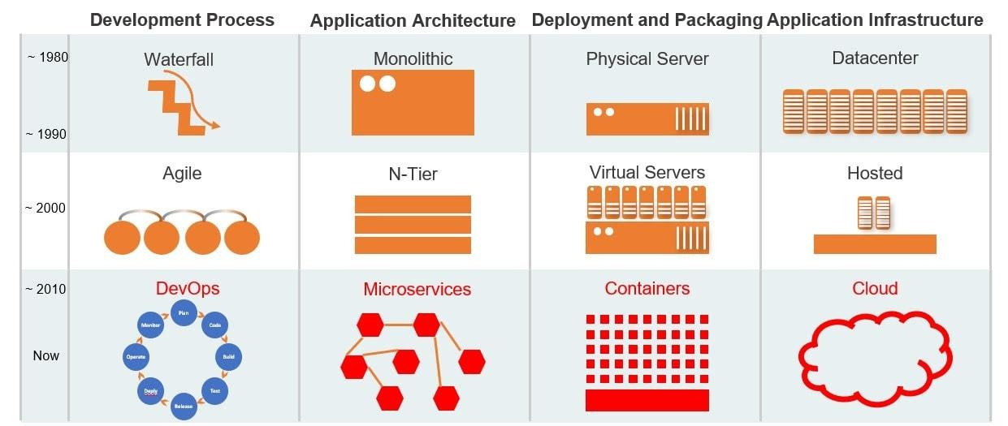
05-04-2025
7. MICROSERVICES
MICROSERVICES – It is basically an architecture that breaks an application into many small and loosely collected services.
This way, you end up reducing complexity and increase flexibility in choice of technology.

Slide 48
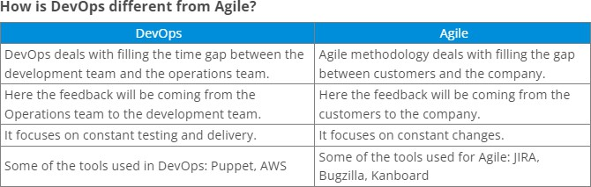
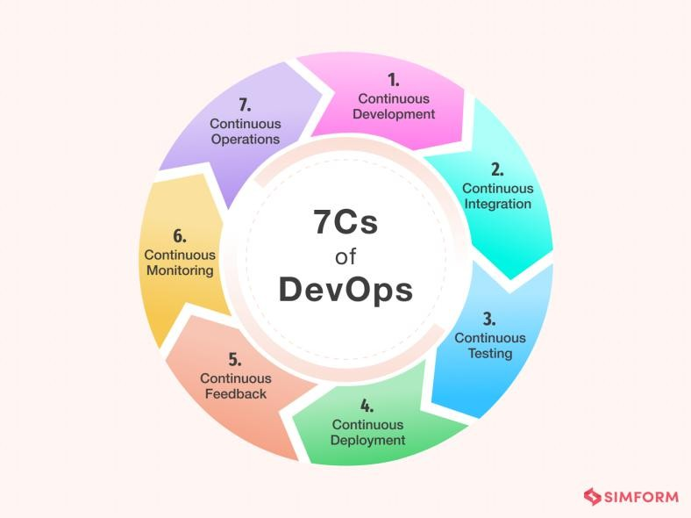
05-04-2025
The 7 key practices of DevOps are :
Configuration Management.
Continuous Integration.
Automated Testing.
Infrastructure as Code.
Continuous Delivery.
Continuous Deployment.
Continuous Monitoring.

Slide 49
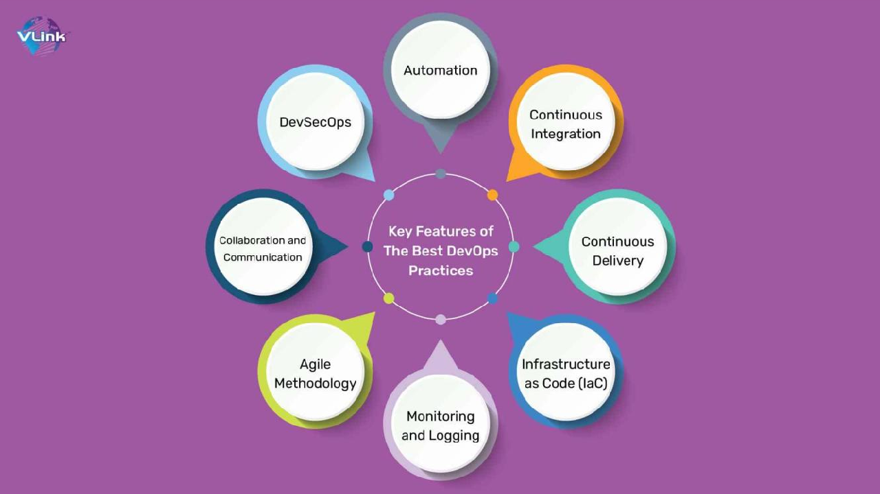
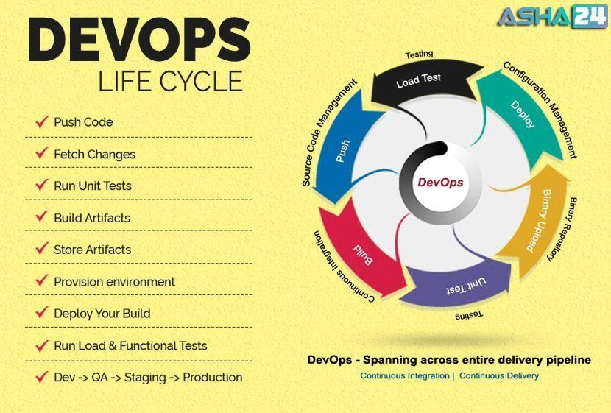
05-04-2025
The Continuous DevOps LifeCycle Process
BITS Pilani, Pilani Campus

Slide 50
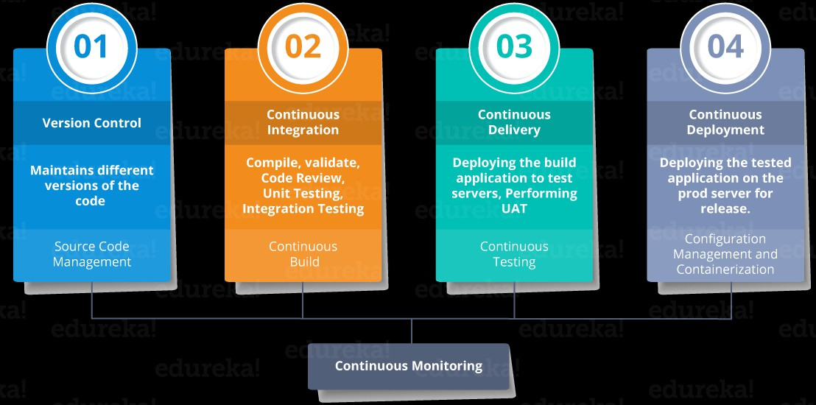

05-04-2025
DevOps Lifecycle Processes
BITS Pilani, Pilani Campus
Continuous Integration,
BITS Pilani, Pilani Campus

Slide 51


05-04-2025
Continuous Inspection,
BITS Pilani, Pilani Campus
Continuous Deployment,
BITS Pilani, Pilani Campus

Slide 52


05-04-2025
Continuous Delivery,
BITS Pilani, Pilani Campus
Continuous Monitoring
BITS Pilani, Pilani Campus

Slide 53


05-04-2025
DevOps Culture
BITS Pilani, Pilani Campus
Continuous Integration, Continuous Inspection, Continuous Deployment, Continuous Delivery, Continuous Monitoring)
BITS Pilani, Pilani Campus

Slide 54


05-04-2025
BITS Pilani, Pilani Campus
DevOps Pipeline
BITS Pilani, Pilani Campus

Slide 55





05-04-2025
Typical Case Study
Delivery pipeline is an automated manifestation of your process for getting software from version control into the hands of your users.
45
BITS Pilani, Pilani Campus
Case Study
DevOps Tools
46
BITS Pilani, Pilani Campus

Slide 56

05-04-2025
Case Study
BITS Pilani, Pilani Campus
Release Antipatterns
Common Quote “The day of a software release tends to be a tense one”
Antipattern: Deploying Software Manually
The production of extensive and detailed documentation for steps to be performed
Reliance on manual testing
Frequent calls to the development team to explain
Frequent corrections to the release process
Sitting bleary-eyed in front of a monitor at 2 A.M
BITS Pilani, Pilani Campus

Slide 57
Problems of Delivering Software
05-04-2025
Release Antipatterns Cond..
Antipattern: Deploying to a Production-like Environment Only after Development Is Complete
Tester tested the system on development machines
Releasing into staging is the first time that operations people interact with the new release
Who Assembles? The Development Team
Collaboration between development and Operations?
Antipattern: Manual Configuration Management of Production Environments
Difference in Deployment to Stage and Production
Different host behave differently
Long time to prepare an environment
Cannot step back to an earlier configuration of a system
Modification to Configuration Directly
BITS Pilani, Pilani Campus
Five different categories of DevOps practices
Treat Ops as first-class citizens from the point of view of requirements
Make Dev more responsible for relevant incident handling
Enforce the deployment process used by all, including
Dev and Ops personnel
Use continuous deployment
Develop infrastructure code, such as deployment scripts
BITS Pilani, Pilani Campus

Slide 58

05-04-2025
Principle of Continuous
Delivery
Create a Repeatable, Reliable Process for Releasing Software Automate Almost Everything
Keep Everything in Version Control
If It Hurts, Do It More Frequently, and Bring the Pain Forward Build Quality In
“The Earlier you catch the defects, the cheaper they are to fix” Done, Means Released
Everybody Is Responsible for the Delivery Process
Continuous Improvement
BITS Pilani, Pilani Campus
NetFlix
https://netflixtechblog.com/how-we-build- code-at-netflix-c5d9bd727f15
BITS Pilani, Pilani Campus

Slide 59

05-04-2025
Facebook
https://netflixtechblog.com/how-we-build-code-at-netflix-c5d9bd727f15
BITS Pilani, Pilani Campus
Facebook
BITS Pilani, Pilani Campus

Slide 60

05-04-2025
facebook
BITS Pilani, Pilani Campus
5 trends that are influencing the adoptions of DevOps
The DevOps process involves an amalgamation of software development and IT operations. The major objective is to reduce the system’s development life cycle, which can provide high software quality along with continuous delivery.
Monolithic to Microservice Architecture Cloud as default
Release and deployment automation Agile infrastructure
AI and ML

Slide 61

05-04-2025
In DevOps multiple tools are used few of them are:
Git - For Version control system
React/Flask/Django or any other webframework or techsta k - For building web app
Docker - For Containerizing , Building image, deployment.
Kubernetes - For Management of containers.
GitHub/Gitlab - For CI/CD(Continuous Integration/Continuous Deployment)

Slide 62


05-04-2025

Slide 63
05-04-2025
Agenda
DevOps Misconceptions and Dimensions
DevOps Misconceptions
DevOps Antipatterns
Three Dimensions of DevOps
DevOps Misconceptions
DevOps Only Involves Developers and System Administrators
As the name indicates Development and Operations
However the Truth is:
DevOps tagline is bring development and operations together
The concepts and ideas of DevOps include all roles within an organization
There is no definitive list of which teams or individuals should be involved
Any team within the organization should be considered as a candidate for DevOps, it may include security, QA, support, and legal

Slide 64
05-04-2025
DevOps Misconceptions Contd..
DevOps is a Team
Creating a team called DevOps, OR
Renaming an existing team to DevOps is neither necessary nor sufficient for creating a DevOps culture
However truth is:
An additional team is likely to cause more communication issues, not fewer
the development and operations teams must connect frequently or it should work together
In a startup environment, having a single team that encompasses both functions can work
DevOps Misconceptions Contd..
DevOps is a Job Title
The “DevOps engineer” job title has started a controversial debate
The job title has been described in various ways
A system administrator who also knows how to write code
A developer who knows the basics of system administration
However truth is:
In DevOps it makes sense to have people become more specialized in their job role
DevOps is at its core a cultural movement, and its ideas and principles need to be used throughout entire organizations in order to be effective

Slide 65
05-04-2025
DevOps Misconceptions Contd..
You Need a DevOps Certification
Certification exams are testing knowledge where there are clear right or wrong answers, which DevOps generally does not have
However truth is:
A significant part of DevOps is about culture: how do you certify culture?
DevOps doesn’t have required technology or one-size-fits-all solutions
DevOps Misconceptions Contd..
DevOps Means Doing All the Work with Half the People
Get both a software developer and a system administrator in one person and with one person’s
salary
However truth is:
Not only is this above perception incorrect, but it is often harmful
At a time startups are offering perks such as three meals a day in the office and on-site laundry as a way of encouraging
DevOps doesn’t save money by halving the number of engineers your company needs
Rather, it allows organizations to increase the quality and efficiency of their work

Slide 66

05-04-2025
DevOps Misconceptions Contd..
DevOps Is About Automation
Many innovations in DevOps-adjacent tools help to codify understanding, bridging the gaps between teams and increasing velocity through automation
Practitioners have focused on tools that eliminate tasks that are boring and repetitive, such as with infrastructure automation and continuous integration.
However truth is:
In both of these above cases, automation is a result of improved technology
Automating repetitive tasks automation will help to human from having to do them, that automation helps that person work more efficiently
Example: Automating server builds saves hours per server that a system administrator can then spend on more interesting or challenging work
DevOps Misconceptions Contd..
DevOps Is a FAD
It’s a Buzzword in Market
Just a new word in place
However truth is:
As DevOps is not specific to a technology, tool, or process however, It is movement about improving organizational effectiveness and individual employee happiness
One of the primary differences between DevOps and methodologies like ITIL and Agile is:
It does not have strict definition
DevOps is movement defined by stories and ideas of individuals, teams, and organizations
DevOps is the evolution of processes and ideas that lead growth and change
Harnessing and leveraging effective DevOps will lead to growth and evolution in tools, technology, and processes in your organization

Slide 67

05-04-2025
DevOps Anti-Patterns
Blame Culture
A blame culture is one that tends toward blaming and punishing people when mistakes are made, either at an individual or an organizational level
Silos
A departmental or organizational silo describes the mentality of teams that do not share their knowledge with other teams in the same company
Root Cause Analysis
Root cause analysis (RCA) is a method to identify contributing and “root” causes of events or near- misses/close calls and the appropriate actions to prevent recurrence
Human Errors
Human error, the idea that a human being made a mistake that directly caused a failure, is often cited as the root cause in a root cause analysis

Slide 68


05-04-2025
Three dimensions of DevOps
3-D of DevOps
People
Process
Tools / Technology
People
DevOps
Process
Automation
Tools

Slide 69

05-04-2025
What is Agile Methodology?
An agile methodology is an iterative approach to software development.
Each iteration of agile methodology takes a short time interval of 1 to 4 weeks.
The agile development process is aligned to deliver the changing business requirement.
It distributes the software with faster and fewer changes.
•
The single-phase software development takes 6 to 18 months.
In single-phase development, all the requirement gathering and risks management factors are predicted initially.
The agile software development process frequently takes the feedback of workable product.
The workable product is delivered within 1 to 4 weeks of iteration.

Slide 70

05-04-2025
Roles in Agile: 1. Scrum Master
There are two different roles in a Agile methodology. These are the Scrum Master and Product Owner.
The Scrum Master is a team leader and facility provider who helps the team member to follow agile practices, so that the team member meets their commitments and customers requirements. The scrum master plays the following responsibilities:
They enable the close co-operation between all the roles and functions.
They remove all the blocks which occur.
They safeguard the team from any disturbances.
They work with the organization to track the progress and processes of the company.
They ensure that Agile Inspect & Adapt processes are leveraged correctly which includes
Planned meetings
Daily stand-ups
Demo
Review
Retrospective meetings, and
Facilitate team meetings and decision-making process.

Slide 71

05-04-2025
Roles in Agile:2. Product Owner
The Product Owner is one who runs the product from a business perspective. The Product Owner plays the following responsibilities:
He defines the requirements and prioritizes their values.
He sets the release date and contents.
He takes an active role in iteration and releasing planning meetings.
He ensures that the team is working on the most valued requirement.
He represents the voice of the customer.
He accepts the user stories that meet the definition of done and defined acceptance criteria.
Cross-functional team
Every agile team contains self-sufficient team with 5 to 9 team members.
The average experience of each member ranges from 6 to 10 years.
The agile team contains 3 to 4 developers, 1 tester, 1 technical lead, 1 scrum master and 1 product owner.
The Scrum master and Product owner are considered as a part of Team Interface, on the other hand remaining members are the part of Technical Interface.

Slide 72


05-04-2025
How an Agile Team plan their work?
An Agile methodology is not a specific set of ceremonies or specific development techniques. Rather, it is a group of methodologies that demonstrate a commitment to tight feedback cycles and continuous improvement.
An Agile team works in iterations to deliver the customer requirement, and each iteration takes 10 to 15 days.
However, the original Agile Manifesto didn't set the time period of two-week iterations or an ideal team size.
Each user requirement is a planned based and their backlog prioritization and size.
The team decides, how much scope they have and how many hours available with each team to perform their planed task.
What is a user requirement?
The user requirement defines the requirements of the user in terms of functionalities. There may be of two type of functionality.
As a <User Role> I want <Functionality> so that <Business Value>
In order to <Business value> as a <User Role> I want <Functionality>.

Slide 73

05-04-2025
What is Software Acceptance Criteria?
Acceptance Criteria is defined as the functionality, behavior, and performance required by a product owner.
It defines what is to be done so that the developer knows when a user
requirement is complete.

Slide 74

05-04-2025
Agenda
Agile Methodology SCRUM
Scrum is an agile development methodology used in the development of Software based on an iterative and incremental processes.
Scrum is adaptable, fast, flexible and effective agile framework that is designed to deliver value to the customer throughout the development of the project.
The primary objective of Scrum is to satisfy the customer’s need through an environment of transparency in communication, collective responsibility and continuous progress.
The development starts from a general idea of what needs to be built, elaborating a list of characteristics ordered by priority (product backlog) that the owner of the product wants to obtain.

Slide 75

05-04-2025
Scrum Methodology & Process
Scrum is precisely an evolution of Agile Management.
Scrum methodology is based on a set of very defined practices and roles that must be involved during the software development process.
It is a flexible methodology that rewards the application of the 12 agile principles in a context agreed by all the team members of the product.
Scrum is executed in temporary blocks that are short and periodic, called Sprints, which usually range from 2 to 4 weeks, which is the term for feedback and reflection.
Each Sprint is an entity in itself, that is, it provides a complete result, a variation of the final product that must be able to be delivered to the client with the least possible effort when requested.

Slide 76


05-04-2025
What are sprints?
With scrum, a product is built in a series of repetition called sprints.
It breaks down big complex projects into bite-size pieces.
It makes projects more manageable, allows teams to ship high quality, work faster, and more frequently.
The sprints give them more flexibility to adapt to the changes.
Sprints are a short, time-boxed period for Scrum team that works to complete a set amount of work.
Sprints are the core component of Scrum and agile methodology.
The right sprints will help our agile team to ship better software.
Scrum master:
Scrum master: The person who leads the team guiding them to comply with the rules and processes of the methodology.
Scrum master manages the reduction of impediments of the project and works with the Product Owner to maximize the ROI.
The Scrum Master is in charge of keeping Scrum up to date, providing coaching, mentoring and training to the teams in case it needs it.

Slide 77
05-04-2025
Product owner (PO):
Product owner (PO): Is the representative of the stakeholders and customers who use the software.
They focus on the business part and is responsible for the ROI of the project.
They Translate the vision of the project to the team, validate the benefits in stories to be incorporated into the Product Backlog and prioritize them on a regular basis.
Team:
Team: A group of professionals with the necessary technical knowledge who develop the project jointly carrying out the stories they commit to at the start of each sprint.

Slide 78


05-04-2025

Slide 79


05-04-2025
In Zoho Sprint- Perform Workspace config
Manage users→ Users and Roles

Slide 80

05-04-2025

Slide 81

05-04-2025
https://youtu.be/GWxMTvRGIpc

Slide 82

05-04-2025
Agenda
DevOps and Agile
Relationship of DevOps practices to agile practices
DevOps Practices over Agile
Traditional, Agile and DevOps – A comparison
DevOps and Agile
Relationship of DevOps practices to agile practices
One of the characterizations of DevOps emphasizes the relationship of DevOps practices to
agile practices
We will focus on what is added by DevOps
We interpret transition as deployment

Slide 83



05-04-2025
DevOps and Agile Contd..
DevOps Practices over Agile
DevOps practices impact all three phases
Inception phase : During the inception phase, release planning and initial requirements specification are done
Considerations of Ops will add some requirements for the developers
Release planning includes feature prioritization but it also includes coordination with operations
personnel
Construction phase: During the construction phase, key elements of the DevOps practices are the management of the code branches,
the use of continuous integration
continuous deployment
incorporation of test cases for automated testing
Transition phase: In the transition phase, the solution is deployed and the development team is responsible for the deployment, monitoring the process of the deployment, deciding whether to roll back and when, and monitoring the execution after deployment
DevOps and Agile Contd..
Traditional, Agile and DevOps – A comparison
Agile breaks the wall between Business and Development team
DevOps breaks the wall between Development and Operations team
DevOps centers on the concept of sharing: sharing ideas, issues, processes, tools and goals
Business
Design
Code
QA
Operations
Inception
Elaboration
Construction
Transition
Elaboration
Construction
Transition
Operations

Slide 84
05-04-2025
Agenda
Agile methodology for DevOps Effectiveness
Why DevOps Process?
DevOps Process: Flow based vs Non flow based
DevOps Process: Component team vs Feature Team
DevOps Process
Why DevOps Process?
We need processes and policies for doing things in a proper way and standardized across the projects so the sequence of operations, constraints, rules and so on are well defined to measure success
We need to set processes for the following things:
Agile planning
Resource planning and provisioning
Configuration management
Role-based access control to cloud resources and other tools used in automation
Static code analysis – rules for programming languages
Testing methodology and tools
Release management

Slide 85
05-04-2025
Agile methodology for DevOps Effectiveness
Flow based and Non flow based
Non-Flow Based
VS
Flow Based
Extreme Programming
SCRUM
KANBAN
Feature Driven Development
Hybrid Agile
DevOps Process
Selecting a Teams Structure
Choosing appropriate team structure (Resource planning)
Component Team Structure
Featured Team Structure

Slide 86







05-04-2025
DevOps Process
Component teams
Made up of experts that specialize in a specific domain
Architecture diagram can be represented as layer of the system
Advantages:
work is always done by people specifically qualified to do the work
work is done efficiently with a low defect density
Team1 (UI)
Team2 (Business logic) Team3 (DB)
Architecture diagram
DevOps Process
Component teams Disadvantages
Working as Component Teams increases the amount of time it
takes to deliver
working in Component Teams will have a negative effect on productivity that cannot be over emphasized
(Example: if business logic team starts on a piece of work, For them to complete the work, they need to define the interface between their layer and the other layers)
Running Component Teams leaves us vulnerable to the risk that they will have to perform non-optimum work at the expense of items that are more valuable to the business
Team1 (UI)
Team2 (Business logic)
Team3 (DB)
Interface

Slide 87

05-04-2025
DevOps Process
Feature Teams
Feature Teams contain multi-disciplined individuals that have the ability and freedom to work in any area of the system
Feature Team usually has at least one member with specialist knowledge for each layer of the system
This allows Feature Teams to work on what are known as ‘vertical slices’ of the architecture
DevOps Process
The characteristics of a feature team
long-lived—the team stays together so that they can ‘jell’ for higher performance; they take on
new features over time
cross-functional and cross-component
co-located
work on a complete customer-centric feature, across all components and disciplines (analysis, programming, testing, …)
composed of generalizing specialists
in Scrum, typically 7 ± 2 people

Slide 88
05-04-2025
DevOps Process
Feature Team Disadvantages
What if untrained or inexperienced employee to deliver a poorly designed piece of work into a live environment
Where do you get the personnel (‘generalizing specialists’)?
DevOps Process
DevOps – Process: Summary on How do you structure your teams
Preferred
Component Teams
Feature
Teams
Component Based structure
Mostly aligned to technology cluster
Faster component Development
Slower feature realization
Integration nightmare
Suitable for platform teams
Business Feature Based structure
aligned to business domains
Faster feature realization
Scale-up problem due to need of cross-functional team
Full-stack engineer
Lower hand-off

Slide 89
05-04-2025
References
https://www.agil8.com/blog/component-teams-vs-feature-teams/
Agenda
Agile Methodologies
Test Driven Development
Feature Driven Development
Behavior Driven Development

Slide 90

05-04-2025
TDD
TDD Introduction
Kent Beck said “Test-first code tends to be more cohesive and less coupled than code in which testing isn’t a part of the intimate coding cycle”
“If you can’t write a test for what you are about to code, then you shouldn’t even be thinking
about coding”
TDD
TDD Three steps
RED
Write a new TEST which fails
GREEN
Write simplest possible code to make it succeed
REFACTOR
Refactor the code (including test code)

Slide 91

05-04-2025
TDD
TDD Technique
TDD is a technique whereby you write your test cases before you write any implementation code
TDD
TDD Overview
Write a test
Refactor the code
Compile
Run test watch it pass
Fix Compile error
Write code
Run test, watch it fail

Slide 92
05-04-2025
TDD
TDD Overview Contd..
How It Works:
Add a Test
Use Cases / User Stories are used to understand the requirement clearly
Run all tests and see the new one fail
Ensures test harness is working correctly
Ensures that test does not mistakenly pass
Write some code
Only code that is designed to pass the test
No additional functionality should be included because it will be untested
Run the automated tests and see them succeed
If tests pass, programmer can be confident code meets all tested requirements
Refactor code
Cleanup the code
Rerun tests to ensure cleanup did not break anything
Repeat
TDD
TDD Overview Contd..
In Extreme Programming Explored (The Green Book), Bill Wake describes the test / code cycle:
Write a single test
Compile it. It shouldn’t compile because you’ve not written the implementation code
Implement just enough code to get the test to compile
Run the test and see it fail
Implement just enough code to get the test to pass
Run the test and see it pass
Refactor for clarity and “once and only once”
Repeat

Slide 93

05-04-2025
TDD
Why TDD
TDD can lead to more modularized, flexible, and extensible code
Clean code
Leads to better design
Better code documentation
More productive
TDD
Test First vs. Test Last
User Story
User Story
Understand
Understand
Add a test case
Implementation
Write code
Write the tests for story
Run all tests
Run all tests
Rework
P
Rework
P
F
Result?
No
F
Result?
Story completed?
Next story
Yes
Next story

Slide 94
05-04-2025
Feature Driven Development
FDD History
Original Creator: Jeff De Luca
Singapore in late 1997
FDD evolved from an actual project
Bank Loan Automation
Luca was Project manager
50 member developer team
Peter Coad : Chief Architect
1990’s object-oriented analysis and design expert
FDD
What is a Feature?
Definition: small function expressed in client-valued terms
FDD’s form of a customer requirement

Slide 95
05-04-2025
FDD
FDD Primary Roles
Project Manager
Chief Architect
Development Manager
Domain Experts
Class Owners
This concept differs FDD over XP
Benefits
Someone responsible for integrity of each class
Each class will have an expert available
Class owners can make changes much quicker, if needed anytime
Easily lends to notion of code ownership
Assists in FDD scaling to larger teams, as we have one person available for complete ownership of feature.
Chief Programmers
FDD
FDD Supporting Roles
Release Manager
Language Guru
Build Engineer
Toolsmith
System Administrator
Tester
Deployers
Technical Writer

Slide 96

05-04-2025
FDD
Feature Driven Development Process
Process #1: Develop an Overall Model
Process #2: Build a Features List
Process #3: Plan By Feature
Constructing the initial schedule, Forming level of individual features, Prioritizing by business value ,
As we work on above factors we do consider dependencies, difficulty, and risks.
These factors will help us on Assigning responsibilities to team members, Determining Class Owners , Assigning feature sets to chief programmers
Process #4: Design By Feature
Goal: not to design the system in its entirety but instead is to do just enough initial design that you are able to build on
This is more about Form Feature Teams: Where team members collaborate on the full low level analysis and design.
Process #5: Build By Feature
Goal: Deliver real, completed, client-valued function as often as possible
FDD
Feature Driven Development Process Contd..

Slide 97
05-04-2025
Behavior Driven Development
BDD Introduction
Behavior-Driven Development (BDD) is a software development process
BDD is considered an effective technical practice especially when the "problem space" for the business is complex
What is BDD?:
General Technique of TDD
Follows same principle as TDD
Shared tools
Shared Process
BDD
BDD Focus
Where to start in the process
What to test and what not to test
How much to test in one go
What to call the tests
How to understand why a test fails
Write failing acceptance test
Write failing unit test
Write failing unit test
Refactor the code
Refactor the code
BDD
TDD

Slide 98
05-04-2025
BDD
BDD Basic structure
BDD consists of cycles of a set of steps to follow.
Identify business feature
Identify scenarios under the selected feature
Define steps for each scenario
Run feature and fail
Write code to make steps pass
Refactor code, Create reusable automation library
Run feature and pass
Generate test reports
BDD
BDD Example
User story:
As someone interested in using the Mobile app, and want to sign up in app to enjoy app membership
Mobile App Signup:
Scenario 1:
Given that I am on the app's "Create new account" screen
Then I should see a "Sign up using Facebook" button
And I should see a "Sign up using Twitter" button
And I should see a "Sign up with email" form field
Then I should see a new screen that asks permission to use my Facebook account data to create my new Mobile app account

Slide 99
05-04-2025
BDD
BDD Sign Use
Functional Documentation in terms of User Stories & Executable Scenarios
Instead of referring to "tests", a BDD practitioner will prefer the terms "scenario" and "specification"
Rather than refer to "functional tests", the preferred term will be "specifications of the product's
behavior"
Specification Names are more expressive
References
http://agilemodeling.com/

Slide 100
05-04-2025
Agenda
DevOps – People
DevOps Team Structure
Team Coordination
Team Structure
Team Size
The size of the team should be relatively small
Amazon has a “two pizza rule”
That is, no team should be larger than can be fed from two pizzas
The advantages of small teams are
They can make decisions quickly
It is easier for individuals to express an opinion
It is easier for individuals to express an idea in front of a small group than in front of a large one
The disadvantage
Some tasks are larger than can be accomplished by a small number of individuals
Task has to be broken up into smaller pieces
A small team, by necessity, works on a small amount of code

Slide 101
05-04-2025
Team Structure
Team Roles
We will study roles in the team from Scott Ambler’s description of roles in an agile team
Team lead :
This role you can relate to “Scrum Master” of SCRUM TEAM.
Also you can relate to Project Lead
Is responsible:
For facilitating the team
Obtaining resources for it
And protecting it from problems
This role encompasses the soft skills of project management but not the technical ones such as planning and scheduling, activities which are better left to the team as a whole.
Team member
This role, sometimes referred to as developer or programmer
Is responsible for the creation and delivery of a system
This includes modeling, programming, testing, and release activities, as well as others
Team Structure
Additional roles
Service owner
Reliability engineer
Gatekeeper
And DevOps engineer

Slide 102
05-04-2025
Team Structure
Service Owner
This role on the team responsible for outside coordination
The service owner participates:
System-wide requirements activities
Prioritizes work items for the team
And provides information both from the clients of the team’s service and about services provided to the
team.
The requirements gathering and release planning activities for the next iteration can occur in parallel with the conception phase of the current iteration
The service owner maintains and communicates the vision for the service
That is, the vision involves the architecture of the overall system and the team’s role in that architecture
Team Structure
Reliability Engineer
Reliability engineer monitors the service in the time period immediately subsequent to the
deployment
Second, the reliability engineer is the point of contact for problems with the service during its execution
Google calls this role “Site Reliability Engineer.”
Once a problem occurs, the reliability engineer performs short-term analysis to diagnose, mitigate, and repair the problem
In any case, the reliability engineer has to be excellent at troubleshooting and diagnosis
The reliability engineer should discover or work with the team to discover the root cause of a problem
Increasingly, reliability engineers need to be competent developers, as they need to write high-
quality programs to automate the repetitive part of the diagnosis, mitigation, and repair

Slide 103

05-04-2025
Team Structure
Gatekeeper
Team Structure
DevOps Engineer
The DevOps engineer role is responsible for the care and feeding of the various tools used in
the DevOps tool chain
The DevOps engineer’s role, as are the tailoring of the tool for the development team and monitoring
The DevOps engineering role is inherent in automating the development and deployment pipeline
DevOps engineer also deals with configuration managements tools which are like Puppet, Ansible and Chef etc.
These configuration management solutions are applied to the source code for the service

Slide 104
05-04-2025
Team Coordination
Forms of Coordination
One goal of DevOps is to minimize coordination in order to reduce the time to market
Two of the reasons to coordinate are, first, so that the pieces developed by the various teams will work together and, second, to avoid duplication of effort
Forms of Coordination
Direct—the individuals coordinating know each other (e.g., team members)
Indirect—the coordination mechanism is aimed at an audience known only by its characterization (e.g. Operators)
Persistent—the coordination artifacts are available after the moment of the coordination (e.g., documents, e-mail, bulletin boards)
Ephemeral—the coordination, per se, produces no artifacts (e.g., face to face meetings, conversations, telephone/video conferencing)
Synchronous—individuals are coordinating in real time, (e.g., face to face)
Asynchronous—individuals are not coordinating in real time (e.g., documents, e-mail)
Team Coordination
Team coordination mechanisms
Team coordination mechanisms are of two types
Human Processes and
Automated Processes
The DevOps human processes are adopted from agile processes and are designed for high- bandwidth coordination with limited persistence
Examples: Stand-up meetings
Automated team coordination mechanisms are designed to protect team members from interference of their and others’ activities:
To automate repetitive tasks (continuous integration and deployment),
And to speed up error detection and reporting (automated unit, integration, acceptance, and live production tests)

Slide 105
05-04-2025
Team Coordination
Cross-team Coordination
Coordination must occur with customers, stakeholders, other development teams, and operations. Therefore, DevOps processes attempt to minimize this coordination as much as possible
There are three types of cross-team coordination:
Upstream Coordination [with stakeholders and customers]
Downstream Coordination [with operations]
And Cross-Stream Coordination [with other development teams]
There are two reasons for a development team to coordinate with other development teams
To ensure that the code developed by one team works well with the code developed by another
And to avoid duplication of effort
Agenda
DevOps People
Transformation to Enterprise DevOps culture

Slide 106
05-04-2025
Transformation to Enterprise DevOps culture
Constraints of Large Enterprise :: DevOps Transformation
Organization Structure
Legacy Technology Stack
Organization Culture
Transformation to Enterprise DevOps culture
Concepts
Executives do not like terms such as “Transformation”
Somehow it is often interpreted as:
Cost Cutting or
Resource Realignment or
Outsourcing
Why organizations are pushing to be DevOps
The intent is to transform the way solutions are being delivered today and to do it faster, cheaper and better
The techniques of Agile and DevOps have been successfully implemented in many large and small organizations to enable those outcomes
Look in to the approach that worked quite well for most enterprises

Slide 107





05-04-2025
Transformation to Enterprise DevOps culture
Initial Planning for Enterprise Readiness
Participants should absolutely include all the towers that make up the solution delivery
Design Thinking : It is a great method; it leverages the expertise of all stakeholders, enables them to come to a common understanding
High Level Output
Participant & Inputs
Design Thinking
High Level Outputs
Transformation to Enterprise DevOps culture
Establish a DevOps Center of Excellence
At the right organizational level and enterprise authority
Create a Face: It has to be led by an enterprise leader who has the support and buy-in from all the towers
Active Participant from All Towers of Delivery & Participants must be chosen wisely
These phases help concrete the vision and strategies of organization and help in setup the best practices to support cultural movement
Authority
Create a Face
Involve All

Slide 108


05-04-2025
Transformation to Enterprise DevOps culture
Establish Program Governance
Agile and DevOps, practitioners’ roles and responsibilities will change
Need awareness, enablement and empowerment to succeed
KPIs must shift from individual metrics to holistic customer business outcomes
Create Communication Plan
Enablement
Program
Establish
Program KPI’s
Transformation to Enterprise DevOps culture
Establish Project In-take Process
DevOps SME’s conduct in-take workshops for Scrum Teams
Automation scripts, Infrastructure assets
Test Automation, Branching and Merging & Lessons Learned
Fit for purpose tool selection and Application Criticality
Reusable Assets
Best Practices
Right Sizing

Slide 109
05-04-2025
Transformation to Enterprise DevOps culture
Identify and Initiate Pilots
Value stream-mapping exercise
Level of detail necessary:
To identify end to end as-is process, tooling, manual and automated processes
And skills and people
Transformation to Enterprise DevOps culture
Scale Out DevOps Program
Onboard Parallel Release Trains
Apply Intake Process
Support, Monitor and Manage

Slide 110
05-04-2025
References
I would like to thank you Mr. Sunil Joshi
https://devops.com/six-step-approach-enterprise-devops-transformation/
DevOps People Dimension
DevOps is a culture
People
DevOps is a cultural movement; it’s all about people
Building a DevOps culture, therefore, is at the core of DevOps adoption
An organization may adopt the most efficient processes or automated tools possible, but they’re useless without the people who eventually must execute those processes and use those tools
DevOps culture is characterized by a high degree of collaboration across roles, focus on business instead of departmental objectives, trust, and high value placed on learning through experimentation
Building a culture isn’t like adopting a process or a tool
It requires social engineering of teams of people, each with unique predispositions, experiences,
and biases
This diversity can make culture-building challenging and difficult
Lean and agile transformation practices are at the core of DevOps

Slide 111
05-04-2025
DevOps People Dimension
Managing People, Not Resources
“Managing teams would be easy if it wasn’t for the people you have to deal with”
Some people react allergically when you call people resources and talk about managing resources
A resource is something you can manage without much tailoring
For an Example: you can treat one bag of sand like the next bag of sand when it comes to
making dikes
With people, that is never true
For an Example: We have probably all been planning for projects and creating a plan that includes a certain amount of “anonymous full-time equivalents (FTEs).” Then a bit later, we start putting names to it and realize that we need more or less effort based on the actual people we have available for the project
One Java developer is just not the same as another; and honestly, we would never consider ourselves to be just a resource whose job someone else could do with the same efficiency and effectiveness
DevOps People Dimension
Don’t change Organization; Change yourself
You will not be able to get the organization to change
But what you can do is change your part of the organization
Manage your teams the way that you would like to be treated
As you climb higher in the hierarchy, your area of influence will increase and, with that, a larger and larger part of the organization will work the way you would like it to

Slide 112
05-04-2025
DevOps People Dimension
Identifying Business Objective
Getting everyone headed in the same direction
And working toward the same goal
“Identify Common Business Objective for the Team and Organization”
Incent the entire team based on business outcomes versus conflicting team incentives
Easy to measure progress of goal for team and organization
DevOps isn’t the goal. It helps you reach your goals
DevOps People Dimension
Effective Management of People
One-On-Ones
Regular one-on-one meetings with the people who report directly to you
Don’t be Anonymous
Having an open-door policy is NOT the same as setting up one-on-ones
Let feel people are important to you
You are making time for them
Best Practices : have weekly or bi weekly 30 minutes one-on –one, learn more about person, let them raise first and provide your updates
Benefit to Manager?
Benefit to Employee?
Feedback
Everyone would like to get more feedback from his or her boss
Dan Pink’s mastery, autonomy, and purpose : “When you do x, y happens, which is not optimal. Can you find a way to do it differently next time to lead to a better outcome? “
Focus on feedback?

Slide 113
05-04-2025
DevOps People Dimension
Effective Management of People Contd..
Delegation
Feel on delegation of JOB to others?
Managerial Economics 101
Creating a Blameless Culture
Who is being blamed?
You will have to cover it without delegating the blame to the person in your team who is responsible
The team will appreciate this
The more you share with the rest of the organization the positive impact a member of your team has made, the better you will look too
These two practices empower the people on your team to do the best job they can for you
Whenever you have failures or problems, your root-cause analysis should not focus on who did what but on how we need to change the system so that the next person is able to avoid making the mistake again
DevOps People Dimension
Effective Management of People Contd..
Measuring Your Organizational Culture
There are a few different ways to measure culture
The Westrum survey measures
On my team, information is actively sought.
On my team, failures are learning opportunities, and messengers of them are not punished.
On my team, responsibilities are shared.
On my team, cross-functional collaboration is encouraged and rewarded.
On my team, failure causes inquiry.
On my team, new ideas are welcomed
There are few more suggestions:
I would recommend the team to my friends as a good place to work.
I have the tools and resources to do my role well.
I rarely think about leaving this team or my company.
My role makes good use of my skills and abilities.
Remember that advice stated before: you can only control your part of the organization

Slide 114
05-04-2025
DevOps People Dimension
Effective Management of People : Lets Summarize
Measuring Your Organizational Culture
Provide your employees:
An organizational structure
The business context and
The necessary feedback
People are factor that makes transformation succeed or fail
Spend enough time and effort on People during the transformation
Agenda
Tools and Technology in DevOps
What is DevOps Tools
Local Development Environment
Version Control
Artifact Management
Automation
Monitoring
Evolution of the Ecosystem

Slide 115
05-04-2025
DevOps Tools
What is DevOps Tools:
What is DevOps Tools:
Tools can be used to improve and maintain various aspects of culture
Software development tools help with the process of programming, documenting, testing, and fixing bugs in applications and services
Not restricted to specific roles, these tools are important to anyone who works on software in
some capacity
Local development environment,
Version control,
Artifact Management,
Automation and Monitoring
DevOps Tools
Local Development Environment
A consistent local development environment is critical to quickly get employees started
contributing to product
Don’t Consider this as limitation:
This is not to say that individuals should be locked into a single standard editor with no flexibility or customization, but rather it means ensuring that they have the tools needed to get their jobs done effectively
Minimal requirements may vary in your environment depending on individual preferences:
Multiple Displays
High-Resolution Displays
Specific Keyboards, Mice, and other Input Devices
Identify a shared area for documenting the local development environment
Documentation can be stored within a version control repository, an internal wiki, or even a Google Doc

Slide 116

05-04-2025
DevOps Tools
Version Control
Having the ability to commit, compare, merge, and restore past revisions of objects to the repository allows for richer cooperation and collaboration within and between teams
Version control enables teams to deal with conflicts that result from having multiple people working on the same file or project at the same time, and provides a safe way to make changes and roll them back if necessary
When choosing the appropriate version control system (VCS) for your environment, look for one that encourages the sort of collaboration in your organization that you want to see
Opening and forking repositories;
Contributing back to repositories;
Curating contributions to your own repositories;
Defining processes for contributing; and
Sharing commit rights
Your Wrong Ways may be:
Lines of code is not an accurate measure of value
DevOps Tools
Artifact Management
An artifact is the output of any step in the software development process
When choosing between a simple repository and more complex feature-full repository, understand the cost of supporting additional services as well as inherent security concerns
An artifact repository should be:
Secure;
Trusted;
Stable;
Accessible; and
Versioned
You can store a versioned common library as an artifact separate from your software version control, allowing all teams to use the exact same shared library

Slide 117
05-04-2025
DevOps Tools
Automation
Automation tools reduce labor, energy, and/or materials used with a goal of improving quality, precision, and accuracy of outcomes
Server Installation
Server installation is the automation of configuring and setting up individual servers
Infrastructure Automation
Configuration Management
Capacity Management
System Provisioning
Test and Build Automation
On-demand automation
Scheduled automation
Triggered automation
Smoke testing
Regression testing
Usability testing
DevOps Tools
Monitoring
Metrics
Metrics are the collection of qualitative and quantitative measurements
Generally they are compared against some benchmark or established standard, tracked for analytics, or tracked for historical purposes
Logging
Logging is the generation, filtering, recording, and analysis of events that occur on a system due to operating system or software messages
When tracking down the source of a software issue, one of the first things that engineers often do is to check the logs for any relevant error messages
A single system can generate hundreds or even thousands of lines of logs a day
Alerting
Monitoring and alerting are important not only from a performance perspective, but also from a preventative one, in that they help you find out about potential issues before they become actual issues for your customers

Slide 118
05-04-2025
DevOps Tools
Monitoring Contd..
Events
Event management is the element of monitoring that acts on existing knowledge around impacts to systems and services
This generally reflects the need for real-time information about the status of all of the different components of infrastructure
A system is configured to monitor a specific metric or log based on a defined event and to signal or alert if a threshold is crossed or an alert condition has been met
Many alerting and monitoring systems have built-in ways to automatically respond to a given event
Nagios, Zabbix, etc.
DevOps Tools
Evolution of the Ecosystem
There is a trend to simplify and remove the repetitive tasks that can be subject to human error
As automation is added to the different parts of the environment, new patterns are discovered
Continuous delivery and continuous deployment have freed humans up to focus on what matters
Automated shortened feedback cycles through build automation with tests give us additional confidence and insight into our systems
The ecosystem will continue to evolve as application development adopts increased operability
These trends bring into focus the tools that stress the “we” over “me,” building understanding across teams and encouraging time spent on valuable outcomes

Slide 119
05-04-2025
DevOps Tools
Summarize
We have been through an overview of the current ecosystem of tools
How tools are used, and the ease with which they can be used, impacts the acceptance and proliferation of specific aspects of culture
The DevOps culture is one of collaboration across teams, organizations, and industries
When developing solutions, it is important to think about their impact on teams and
organizations, not just individuals
DevOps tools stress “we” over “me”; they allow teams and organizations to build mutual understanding to get work done
Agenda
Cloud as a catalyst for DevOps
Introduction
Characterization of the cloud
Cloud services

Slide 120
05-04-2025
Cloud as a Catalyst for DevOps
Introduction
Unfortunately for many organizations, the cloud is still somewhat mysterious
Not the concept of the cloud but why they are not seeing the benefits that were promised to them
The focus is on adopting cloud-based infrastructure and managing it
While we will discuss cost benefits primarily, one should not forget the other benefits and risks of the cloud
Benefits:
Redundancy for resilience
The scalability of resources
The strong ecosystem of related
Risks:
The dependency on a third-party provider
The challenges with data sovereignty
Risk of being attacked because you are on a popular platform
Cloud as a Catalyst for DevOps
Characterization of the cloud
Characterization of the cloud by National Institute of Standards and Technology (NIST)
On-demand self-service
Broad network access
Resource pooling
Rapid elasticity
It is the Capabilities can be elastically provisioned and released
Measured service
Software as a Service (SaaS)
Platform as a Service (PaaS)
Infrastructure as a Service (IaaS)

Slide 121
05-04-2025
Cloud as a Catalyst for DevOps
Software as a Service (SaaS)
In this the consumer is provided the capability to use the provider’s applications running on a cloud infrastructure
The applications are accessible from various client devices through either a thin client interface, such as a web browser (e.g., web-based e-mail) or an application interface.
The consumer does not manage or control the underlying cloud infrastructure including
networks, servers, operating systems, storage.
For an example, you can relate google apps, Cisco WebEx, as a Service, Office 365 service, where Provider deals with the licensing of software’s
Cloud as a Catalyst for DevOps
Platform as a Service (PaaS)
The consumer is provided the capability to deploy onto the cloud infrastructure consumer- created or acquired applications created using programming languages, libraries, services, and tools supported by the provider
The consumer does not manage or control the underlying cloud infrastructure including networks, servers, operating systems, or storage, but consumer has control over the deployed applications and possibly configuration settings for the application-hosting environment
For an Example: .NET Development platform is considered as a platform

Slide 122
05-04-2025
Cloud as a Catalyst for DevOps
Infrastructure as a Service (IaaS),
The consumer is provided the capability to provision processing, storage, networks, and other fundamental computing resources where the consumer is able to deploy and run arbitrary software, which can include operating systems and applications
The consumer does not manage or control the underlying cloud infrastructure but consumer has control over operating systems, storage, and deployed applications; and possibly limited control of select networking components (e.g., host firewalls). For this you can consider any Server Provisioning is IaaS,
Cloud as a Catalyst for DevOps
Summary
The cloud has emerged as a major trend in IT during recent years
Its characteristics include metered usage (pay-per-use) and rapid elasticity, allowing the scaling out of an application to virtually infinite numbers of VMs
The cloud rests on a platform that is inherently distributed and exploits virtualization to allow rapid expansion and contraction of the resources available to a given user
From an operational perspective, controlling the VMs, managing different database management systems, and ensuring the environments meet the needs of the development and operations tasks are new considerations associated with the cloud

Slide 123








DevOps
People
Process
Tools
Culture
Interactions
Automation
Process:
Sequence or layers of procedures that is consisted of people, machines, materials, methods and governing policies that are used all together to design and delivery a good or service (product) . Conversion of an input into an output through-outprocedures.
Practice:
Series of steps to achieve a consistent result (output).
A simple process may be described by a single procedure. But a more complex process, will have multiple procedures.
BITS Pilani, Deemed to be University under Section 3 of UGC Act, 1956

Slide 124


Dimensions of DevOps
Three dimensions of DevOps People
Initially, stakeholders would need to be identified, ensuring that everybody delivering value to the business are working tightly together on the common goal of adding value to the customer.
Highly motivated people with good collaboration is necessary
Process
Process of designing, building and testing software should be well presented to each individual team member
Processes and practices that help improve the value and delivery to customers
Tools
Tools and services that can help enable different DevOps practices and different teams which can be used to make things easier
BITS Pilani, Deemed to be University under Section 3 of UGC Act, 1956

Slide 125


DevOps– People
Addresses the people aspect of adopting DevOps, including creating the necessary culture.
An organization may adopt the most efficient processes or automated
tools possible, but they’re useless without the people who eventually must execute those processes and use those tools.
DEVOPS CULTURE
(1) Identifying business objectives
Creating a culture is getting everyone direction and working toward the same goal
Identifying common business objectives organization as a whole.
headed in the same
for the team and the
identify goals that it wants to achieve; then it can develop a common set of milestones toward those goals for different teams
of stakeholders to use Collaboration and communication across
stakeholders
BITS Pilani, Deemed to be University under Section 3 of UGC Act, 1956

Slide 126
DevOps– People
2) Create an environment of sharing
leaders of the organization to work with their teams to create an environment and culture of collaboration andsharing.
Leaders must remove any self-imposed barriers to cooperation.
Typical measurements reward operations teams for uptime and stability, and reward developers for new features delivered, but they pit these groups against each other.
The leaders of the organization should further encourage collaboration by improving visibility. Establishing a common set of collaboration tools is essential, especially when teams are geographically distributed and can’t work together in person.
Giving all stakeholders visibility into a project’s goals and statusis
crucial for building collaboration.
a DevOps culture based on trust and
8
BITS Pilani, Deemed to be University under Section 3 of UGC Act, 1956

Slide 127
DevOps– People
DEVOPS TEAM
The arguments for and against having a separate DevOps team are as old as the concept itself.
DevOps liaison teams, which resolve any conflicts and promote collaboration.
Such a team may be an existing tools group or process group, or it may be a new team staffed by representatives of all teams that have a stake in the application being delivered.
DevOps team, your most important goal is to ensure that it functions as a Center of Excellence that facilitates collaboration without adding a new layer of bureaucracy or becoming the team that owns addressing all DevOps related problems
9
BITS Pilani, Deemed to be University under Section 3 of UGC Act, 1956

Slide 128


Test Driven Development
BITS Pilani, Deemed to be University under Section 3 of UGC Act, 1956

Slide 129

Test Driven Development
BITS Pilani, Deemed to be University under Section 3 of UGC Act, 1956

Slide 130



Agile Teams
BITS Pilani, Deemed to be University under Section 3 of UGC Act, 1956

Slide 131


From Agile to DevOps
BITS Pilani, Deemed to be University under Section 3 of UGC Act, 1956

Slide 132


c
BITS Pilani, Deemed to be University under Section 3 of UGC Act, 1956

Slide 133

From Agile to DevOps
BITS Pilani, Deemed to be University under Section 3 of UGC Act, 1956

Slide 134

Component Teams
BITS Pilani, Deemed to be University under Section 3 of UGC Act, 1956

Slide 135

From Agile to DevOps
BITS Pilani, Deemed to be University under Section 3 of UGC Act, 1956

Slide 136

From Agile to DevOps
BITS Pilani, Deemed to be University under Section 3 of UGC Act, 1956

Slide 137

Infra evolution
BITS Pilani, Deemed to be University under Section 3 of UGC Act, 1956

Slide 138

BITS Pilani, Deemed to be University under Section 3 of UGC Act, 1956

Slide 139

Squad
BITS Pilani, Deemed to be University under Section 3 of UGC Act, 1956

Slide 140
Squad
A Squad is similar to a Scrum team.
They sit together, and they have all the skills and tools needed to design, develop, test, and release to production.
They are a self-organizing team and decide their own way of working – some use Scrum sprints, some use Kanban, some use a mix of these approaches.
A tribe is a collection of squads that work in related areas – such as the web application, support, or backend infrastructure.
The chapter is your small family of people having similar skills and working within the same general competency area, within the same tribe.
A Guild is a more organic and wide-reaching “community of interest”, a group of people that want to share knowledge, tools, code, and practices. Chapters are always local to a Tribe, while a guild usually cuts across the whole organization
BITS Pilani, Deemed to be University under Section 3 of UGC Act, 1956

Slide 141

DevOps – Roles & Responsibilities
BITS Pilani, Deemed to be University under Section 3 of UGC Act, 1956

Slide 142

DevOps– People
Key competencies to succeed
Culture – Shared organizational assumptions to resolve problems Leadership
visioning, strategic management, flexibility, and the ability to inspire others to innovate and perform
individuals with advanced communications skills, the knowledge of diverse cultures, and people who behave collaboratively when working in teams
Resource/management
effective management of availableresources
collaboration across multi-functional teams is at the heart of DevOps, delivering an accountable business outcome
Subject matter experts (SME’s) in different areas like – Automation, Build &
Release management, CI/CD, Containers, Security, Cloud (AWS/GCP/Azure)
DevOps engineers who are members from different department
(development, QA, Operations )
10
BITS Pilani, Deemed to be University under Section 3 of UGC Act, 1956

Slide 143


DevOps– Tools
Enables people to focus on high-value creative work while delegating routine tasks to automation. Technology also allows teams of practitioners to leverage and scale their time and abilities. Organization has to reuse assets, code, and practices to be cost- effective and efficient.
Standardizing automation also makes people more effective common set of tools allows practitioners to work anywhere, and new team members need to learn only one set of tools and a process that’s efficient, cost-effective, repeatable, and scalable.
Categorized into major areas are Infrastructure as Code Delivery Pipeline
Deployment automation and release management
12
7
BITS Pilani, Deemed to be University under Section 3 of UGC Act, 1956

Slide 144

DevOps - Tools
BITS Pilani, Deemed to be University under Section 3 of UGC Act, 1956

Slide 145

DevOps - Tools
BITS Pilani, Deemed to be University under Section 3 of UGC Act, 1956

Slide 146

DevOps - Tools
BITS Pilani, Deemed to be University under Section 3 of UGC Act, 1956

Slide 147

DevOps - Tools
BITS Pilani, Deemed to be University under Section 3 of UGC Act, 1956

Slide 148

DevOps - Tools
BITS Pilani, Deemed to be University under Section 3 of UGC Act, 1956

Slide 149

BITS Pilani, Deemed to be University under Section 3 of UGC Act, 1956

Slide 150

BITS Pilani, Deemed to be University under Section 3 of UGC Act, 1956

Slide 151

BITS Pilani, Deemed to be University under Section 3 of UGC Act, 1956

Slide 152

DevOps - Tools
BITS Pilani, Deemed to be University under Section 3 of UGC Act, 1956

Slide 153

DevOps - Tools
BITS Pilani, Deemed to be University under Section 3 of UGC Act, 1956

Slide 154

DevOps - Tools
BITS Pilani, Deemed to be University under Section 3 of UGC Act, 1956

Slide 155

DevOps - Tools
BITS Pilani, Deemed to be University under Section 3 of UGC Act, 1956

Slide 156

DevOps - Tools
BITS Pilani, Deemed to be University under Section 3 of UGC Act, 1956

Slide 157

DevOps - Tools
BITS Pilani, Deemed to be University under Section 3 of UGC Act, 1956

Slide 158

DevOps - Tools
BITS Pilani, Deemed to be University under Section 3 of UGC Act, 1956

Slide 159

DevOps - Tools
BITS Pilani, Deemed to be University under Section 3 of UGC Act, 1956

Slide 160

DevOps - Tools
BITS Pilani, Deemed to be University under Section 3 of UGC Act, 1956

Slide 161

DevOps - Tools
BITS Pilani, Deemed to be University under Section 3 of UGC Act, 1956

Slide 162

DevOps– Infrastructure as Code
organizations to manage the scale and the speed with which environments need to be provisioned and configured to enable continuous delivery/deployment.
Infrastructure as code is the notion of software-defined environments
Infrastructure as code deals with capturing node definitions and configurations as code software-defined environments use technologies that define entire systems made up of multiple nodes not just their configurations, but also their definitions, topologies, roles, relationships, workloads and workload policies, and behavior.
Application or middleware-centric tools -code both application
servers and the applications that run on them. Automate server and application-level tasks
Generic tools -scripted to perform several kinds of tasks, all the way from configuring an OS on a virtual or physical node to configuring firewall
ports
23
BITS Pilani, Deemed to be University under Section 3 of UGC Act, 1956

Slide 163

DevOps– Delivery pipeline
A delivery pipeline consists of the stages an application goes
through from development through to production
Stages may vary from one organization to another.
Some organizations fully automate their delivery pipelines; others put their software through manual checks and gates due to regulatory or company requirements.
BITS Pilani, Deemed to be University under Section 3 of UGC Act, 1956

Slide 164
DevOps– Delivery pipeline
Development environment
provides multiple tools that enable the developers to write and test code. Beyond the integrated development environment (IDE) tools
Developers use to write code, this stage includes tools that enable collaborative development, such as tools for source control management, work-item management, collaboration, unit testing, and project planning.
Tools in this stage typically are cross-platform and cross-technology.
Build stage
code is compiled to create and unit test the binaries to be deployed.
organizations typically use build servers to facilitate the large number of
builds required on an ongoing basis to enable continuous integration
BITS Pilani, Deemed to be University under Section 3 of UGC Act, 1956

Slide 165

DevOps– Delivery pipeline
Package repository (artifact repository)
common storage mechanism for the binaries created during the build stage need to store the assets associated with the binaries to facilitate their deployment, such as configuration files, infrastructure-as-code files, and deployment scripts
Test environment
QA, user acceptance, and development/ testing teams do the actual testing. Many tools are used
Test environment management: These tools facilitate provisioning and configuring the test environments.
Infrastructure-as-code technologies and cloud provisioning and management tools.
BITS Pilani, Deemed to be University under Section 3 of UGC Act, 1956

Slide 166
DevOps– Delivery pipeline
Test environment management
Environment (Infrastructure) Orchestration Tool
Build & Deployment Tools / Continuous Integration Tools Infrastructure Configuration Tools
Service Support Tools (Incident & Change) Environment Health Dashboards
Ex: Jenkins for app builds, Puppet for infrastructure configuration, CA Lisa for service virtualization
15
0
BITS Pilani, Deemed to be University under Section 3 of UGC Act, 1956

Slide 167
DevOps– Delivery pipeline
Test data management (TDM):
Administration of the data necessary for fulfilling the needs of
automated test processes.
TDM should also ensure the quality of at the correct time.
the data, as well as its availability
To enable continuous testing, managing test data is an essential function. Ex: IBM InfoSphere Optim , Informatica Test Data Management
Integration, functional, performance, and security testing tools: Automated tools are available for each of these types of tests.
Tools should be integrated with a common test asset management tool or repository where all test scenarios, test scripts, and associated results can be stored and traceability established back to code, requirements, and defects.
15
1
BITS Pilani, Deemed to be University under Section 3 of UGC Act, 1956

Slide 168
DevOps– Delivery pipeline
Service virtualization:
Modern applications aren’t simple, monolithic applications.
They’re complex systems that are dependent on other applications, application servers, databases, and even third-party applications and data sources.
Unfortunately, at test time, these components may be unavailable or costly.
Service virtualization solutions simulate the behavior — functionality and performance of select components within an application to enable end- to-end testing of the application as a whole.
Create stubs (virtual components) of the applications and services that are required for the tests to run.
Ex: IBM’s Rational Test Virtualization Server, Soap UI, Microfocus
15
2
BITS Pilani, Deemed to be University under Section 3 of UGC Act, 1956

Slide 169
DevOps– Delivery pipeline
Stage and production environments
Applications are deployed in the staging and production
environments.
Tools used in these stages include environment management and provisioning tools.
Tools for infrastructure as code also play a critical role in these stages, due to the large scale at which the environment in these stages exist.
With the advent of virtualization and cloud technologies, stage and production environments can today be made up of hundreds or even thousands of servers. Monitoring tools allow organizations to monitor the deployed applications in production.
BITS Pilani, Deemed to be University under Section 3 of UGC Act, 1956

Slide 170

DevOps– Deployment automation and release management
Managing the automation of application deployment from one stage to the next requires specialized tools
Deployment automation Core tools in the DevOps
Perform orchestrated deployments and track which version is deployed on which node at any stage of the build and delivery pipeline
Can also manage the configurations of the environments of all the stages to
which the application components must be deployed.
Manage
Middleware components middleware configurations
Database components that need to be changed;
Environment configuration
capture and automate the processes to carry out these deployments and configuration changes.
BITS Pilani, Deemed to be University under Section 3 of UGC Act, 1956

Slide 171
DevOps– Deployment automation and release
management
Release management
Orchestrating the release plans and deployments associated with each release requires coordination across the business, development, QA, and operations teams.
Release management tools allow organizations to plan and execute releases,
provide a single collaboration portal for all stakeholders in a
release, and provide
traceability for a release stages of the build and
and its delivery
components across all pipeline.
15
5
BITS Pilani, Deemed to be University under Section 3 of UGC Act, 1956

Slide 172





DevOps– Cloud as a catalyst
Essential Characteristics
On-demand Self-service
Resource pooling
Broad network access
Rapid Elasticity
Measured Service
Scalability:
Ability to system to handle increasing workload by increasing in
proportion the amount of resource capacity.
Architecture allows on-demand resources for increasing workload
Elasticity:
Dynamically Commissioning and decommissioning of resources
Speed at which resources are provisioned on demand and usage of resources
33
BITS Pilani, Deemed to be University under Section 3 of UGC Act, 1956

Slide 173



DevOps– Cloud as a catalyst
Private Cloud
Private Cloud: The infrastructure is operated solely for an organization. It may be managed by the organization or a third party and may exist on or off the premises of the organization.
Public Cloud
Public Cloud: The infrastructure is made available to the general public or a large industry group and is owned by an organization selling cloud services.
Hybrid Cloud: The infrastructure is a composition of two or more clouds
Hybrid Cloud
(private, community, or public) that remain unique entities but are bound together by standardized or proprietary technology that enables data and application portability.
BITS Pilani, Deemed to be University under Section 3 of UGC Act, 1956

Slide 174
Virtualization
A virtual machine (VM) is a software implementation of a machine (for example, a computer) that executes programs like a physical machine
Each VM is fully protected and isolated copy of physical machine. It is used to share
the expensive hardware which helped to reduce costs and also helped to improve the productivity as many users can concurrently used the same hardware
Need for Server virtualization
In the case of server consolidation, many small physical servers are replaced by one larger physical server to increase the utilization of costly hardware resources such as CPU.
A virtual machine can be more easily controlled and inspected from outside than a physical one, and its configuration is more flexible.
A new virtual machine can be provisioned as needed without the need for an
up- front hardware purchase.
BITS Pilani, Deemed to be University under Section 3 of UGC Act, 1956

Slide 175
Container
Containers and VMs
To isolate an application and its dependencies into a self-contained unit that can run anywhere
Remove the need for physical hardware, allowing for more efficient use of
computing resources, both in terms of energy consumption and cost effectiveness.
Containers
virtualize at the operating system level, with multiple containers running atop the OS kernel directly
container provides operating-system-level virtualization by abstracting the “user space”
ability to create predictable environments that are isolated from other applications
run virtually anywhere, greatly easing development and deployment
virtualize CPU, memory, storage, and network resources at the OS-level, providing developers with a sandboxed view of the OS logically isolated from other applications.
Ex: Docker, LXC, Kubernetes, FreeBSD Jails etc..
BITS Pilani, Deemed to be University under Section 3 of UGC Act, 1956

Slide 176

DevOps– Cloud as a catalyst
Cloud is key enabler and has affected DevOps. It helps DevOps to mature.
In traditional organizations that use physical servers, requesting a new server is a complex, time-consuming process. It may take days or even weeks to requisition a new physical server, install and set up the operating system (OS), and configure all the software required to deploy the application.
Pervasiveness of cloud technology, private, public, and hybrid, has enabled organizations to provision environments on demand.
Virtualization in Cloud solve that problem to a large extent. This has led to
tremendous growth in the scale by which the environments to which applications are deployed are used.
This scale has necessitated automation on software deployment tasks, which DevOps addresses
Ability to create and switch environments simply, the ability to create VMs
easily, and the management of databases etc..
BITS Pilani, Deemed to be University under Section 3 of UGC Act, 1956

Slide 177
DevOps– Cloud as a catalyst
advent of cloud actually facilitates continuous deployment and provides easier access to production like environments during the development and testing stages of the deliverypipeline.
Developer can not only invoke an automated build, but also request the provisioning and configuration of a production like environment in the cloud and then deploy the application being built to it without any direct involvement by the operations team.
BITS Pilani, Deemed to be University under Section 3 of UGC Act, 1956

Slide 178

DevOps– Cloud as a catalyst
BITS Pilani, Deemed to be University under Section 3 of UGC Act, 1956

Slide 179
DevOps– Tools/technology as
enablers
Phase | Purpose | Tools
Development | Source control | Git, SVN, CVS
 | Static Code Analysis | SonarQube, FindBugs, CheckStyle,PMD
 | CI | Jenkins, pupper, cruise control,Anthil
Testing | Unit and Performance | Junit, TestNG,Jmeter,Selenium,cucumber, SOAP UI,HtmlUnit
 | Code Coverage | Jacaco, Cobertura
Release | Build and Release | ANT, Maven, Gradle
Deployment | Deployment Automation | Jenkins plugin,deployment scripts
Monitoring and Maintenance | Continuous monitor | Web analytics scripts, health monitoring tools, server monitoring tools
40
BITS Pilani, Deemed to be University under Section 3 of UGC Act, 1956

